Slide 1
Digital Media literacy syllabus Module 3 Digital story telling

Slide 3
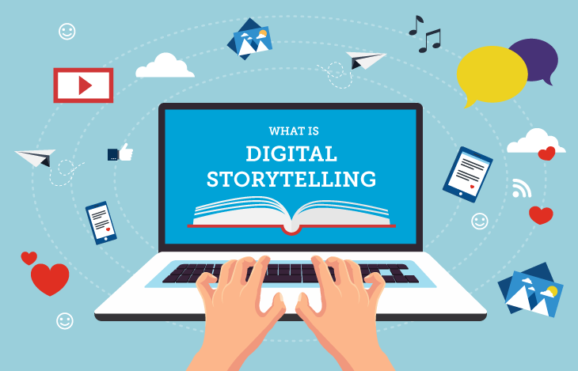
Introduction:
Storytelling is an ancient art form that transcends time and culture.
It is a powerful tool that goes beyond entertainment; it is a fundamental aspect of human communication.
Live Example:
TED Talk Clip: Show a brief clip from a TED Talk where a speaker effectively uses storytelling to convey a message or share an idea.
11/24/2023 12:27 PM
3

Slide 4
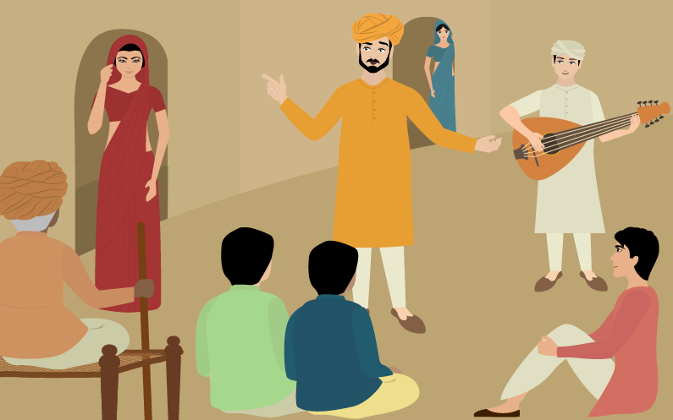
Elements of a Compelling Story
Characters, plot, setting, conflict, resolution, etc.
Provide examples from famous stories or movies.
11/24/2023 12:27 PM
4

Slide 5
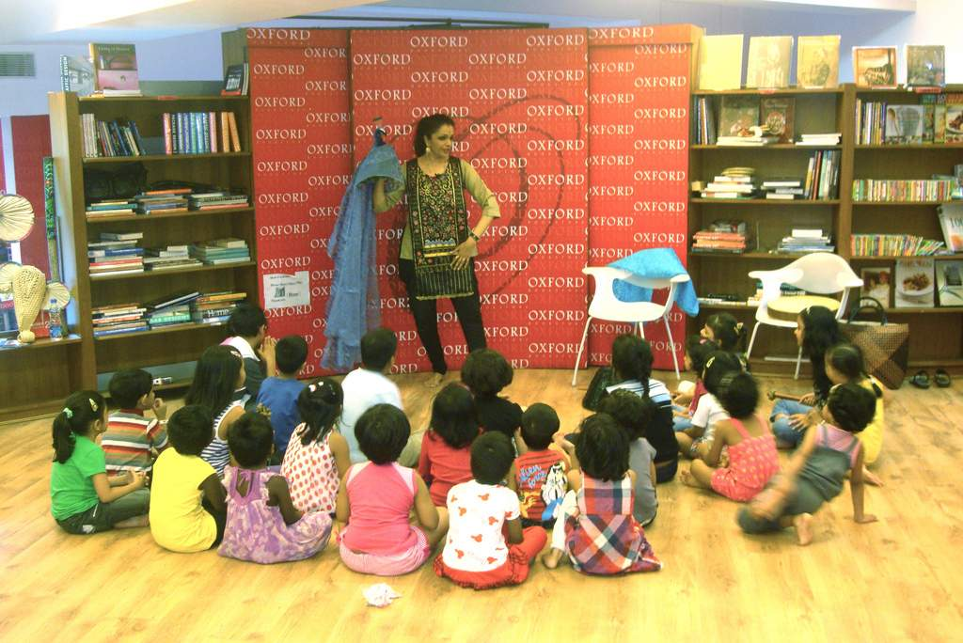
Types of Stories
Folktales, myths, personal narratives, fiction, non-fiction, etc.
Highlight the diversity of storytelling.
11/24/2023 12:27 PM
5

Slide 6
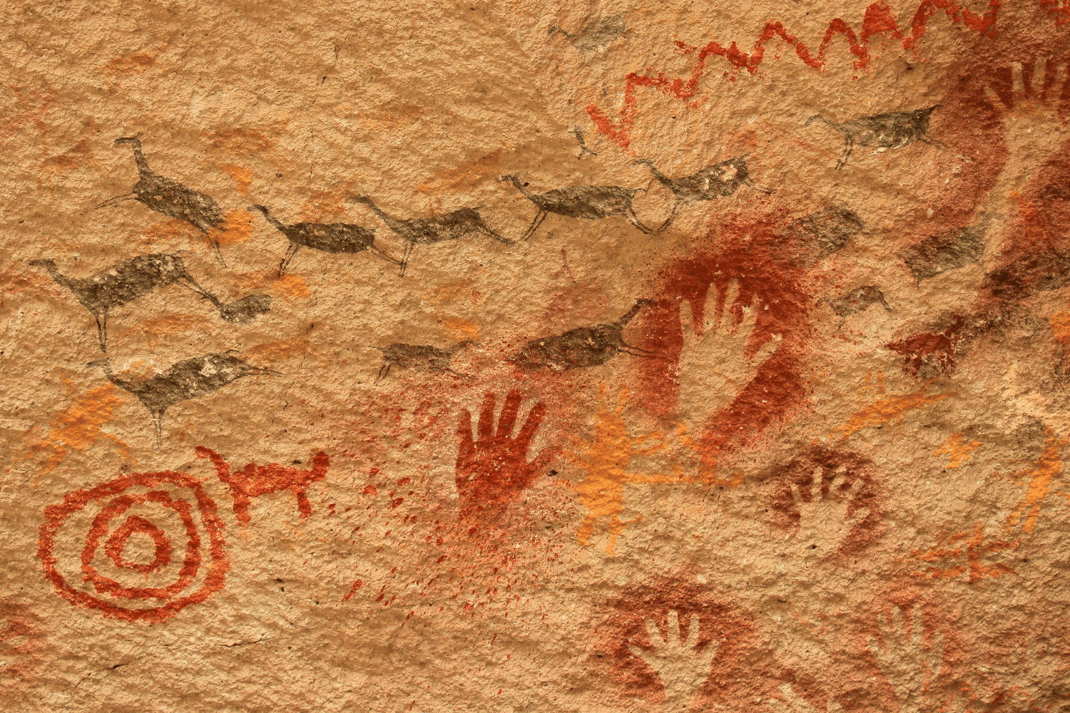
Assignment:
Creative Writing
Encourage students to write a short story incorporating various storytelling techniques.
Provide prompts if needed.
Cultural Storytelling
Ask students to research and share a traditional story from their culture.
Discuss the influence of culture on storytelling.
11/24/2023 12:27 PM
6

Slide 7
Writing for Digital Media
Digital media writing involves publishing pieces for consumption through online methods, such as social media and news websites…
11/24/2023 12:27 PM
7

Slide 8
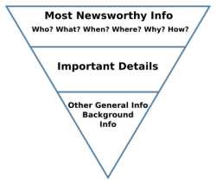
Contd…
Audience-Centric Approach:
Understand the target audience and tailor content to their preferences.
Consider the digital platform and its specific user demographics.
Concise and Scannable Content:
Users often skim online content; make it easy to read.
Use short paragraphs, subheadings, and bullet points for better readability.

Slide 9
Social Media Integration:
Craft content that is shareable on social media platforms.
Utilize social media to promote and distribute your digital content.
Authenticity and Transparency:
Build trust through transparent and authentic communication.
Clearly disclose sponsored content or any potential conflicts of interest.
Visual Appeal:
Use engaging visuals such as images, infographics, and videos.
Ensure multimedia elements enhance the message without overwhelming it.
Hyperlinking and Navigation:
Include relevant hyperlinks to provide additional context or resources.
Ensure a clear and intuitive navigation structure for a seamless user experience.
11/24/2023 12:27 PM
9

Slide 10
Storytelling in Digital Format:
Leverage the power of storytelling in blog posts, articles, or social media updates.
Create a narrative that resonates with the audience.
Editing for Online Reading Habits:
Edit for clarity and brevity.
Break up long sentences and paragraphs for better online readability.
11/24/2023 12:27 PM
10

Slide 11
Impact on Media Industries
Publishing and Journalism:
Decline of traditional print media.
Adaptation to digital formats, paywalls, and content distribution challenges.
Entertainment and Broadcasting: Shift from traditional TV and radio to online streaming.
The rise of online influencers and content creators.
11/24/2023 12:27 PM
11

Slide 12
Multimedia storytelling techniques
combines various forms of media to create a richer and more engaging narrative.
Visual Storytelling:
Use images, infographics, and videos to complement the narrative.
Encourage students to create a storyboard for their stories, incorporating visuals strategically.
Audio Elements:
Utilize background music, sound effects, or voiceovers to enhance emotional impact.
Assignment: Have students create a short audio story, focusing on the effective use of sound.

Slide 13
Digital Platforms:
Explore digital tools and platforms like podcasts, blogs, or social media for storytelling.
Assignment: Create a multimedia story suitable for a specific digital platform.

Slide 14
Assignment: Multimedia Storytelling Project
Choose a Story: Select a short story or create your own narrative.
Multimedia Elements: Incorporate at least three different multimedia elements into your storytelling project (visuals, audio, interactive features, etc.).
Platform Selection: Decide on the platform where your story will be presented (e.g., blog, podcast, social media, etc.).
Storyboarding: Create a storyboard outlining the sequence of your story and how each multimedia element will be integrated.
Presentation: Prepare a short presentation to explain your choices of multimedia elements, platform, and the overall impact you aim to achieve.

Slide 15
Podcasting and Narrative Strategies.
Podcasting is a dynamic and accessible medium for storytelling, allowing people to explore their creativity and communication skills.

Slide 16
Character Development:
Introduce compelling characters to captivate the audience.
Plot Structure:
Follow a clear and engaging plot structure (introduction, rising action, climax, falling action, resolution).
Use of Sound:
Leverage background music, sound effects, and varied tones of voice.

Slide 17
Narrative Voice:
Develop a consistent and engaging narrative voice.
Assignment: Record a short monologue experimenting with different narrative styles.

Slide 18
Assignment…
Choose a Topic: Select a topic that interests you and your potential audience.
Narrative Elements: Incorporate at least three narrative strategies discussed (character development, plot structure, use of sound, interview techniques, narrative voice).
Script Writing: Write a script for your podcast episode, ensuring clarity and engaging storytelling.
Recording: Record your podcast episode, paying attention to tone, pacing, and the use of sound.
Editing: Edit your podcast for a polished final product.
Presentation: Share your podcast episode with the class, discussing the narrative strategies employed.

Slide 19
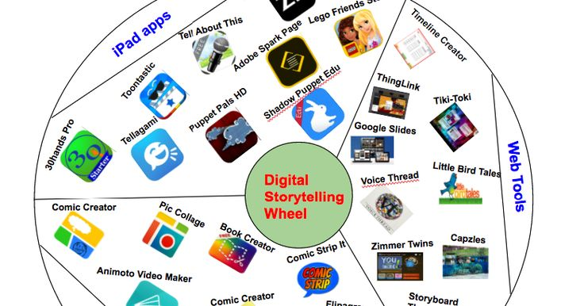
Conclusion…
Digital storytelling is not merely a feature of the digital age; it is the heartbeat of effective communication in the digital realm information.
. It bridges the gap between information and emotion, making content not just consumable but memorable.

