Slide 1
PLANET HOPE ASIA
Durga.D

Slide 2
SESS
Why set GOALS?
What are your goals?
What is it?
List all The Goals & prioritize
What Would you Do to Work toward your Goal
Resources Required

Slide 3
FINANCIAL DEPENDANT V/S INDEPENDANT
independent is when one does not have to rely on something or somebody, It is when they only rely on themselves.
a state in which an individual or household has sufficient wealth to live on without having to depend on income from some form of employment'.
when someone does have to rely on somebody else
the state of a relationship in which one partner financially depends on the other.

Slide 4
Spending Patterns
EXAMPLES OF BAD SPENDING
Frequent Spending on Small Items. ...
Shopping as a Habit. ...
Impulse Buying. ...
Paying Bills Late. ...
Not Tracking Spending. ...
Missing Savings Goals.
(Track your Spending, Control your impulses, Stop trying to impress other people, Figure out what Habit drain your budget, Learn to value investing over Products etc.…)
Show video

Slide 5
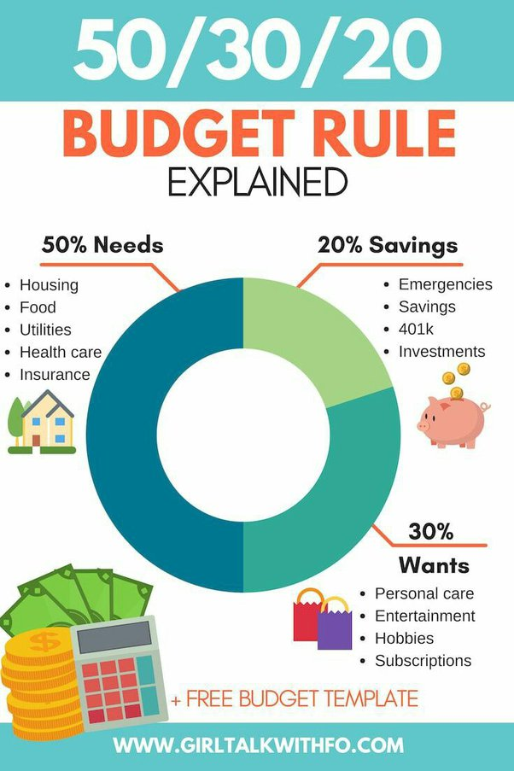
What is Budgeting
A budget is an estimation of revenue and expenses over a specified future period of time and is usually compiled and re-evaluated on a periodic basis.

Slide 6
INCOME
Where does your income come from?
Where does your Money Go?
What to Spend and Where to Spend the Money ?
(eg. Clothing, food, Groceries, Automobile etc.…)

Slide 7
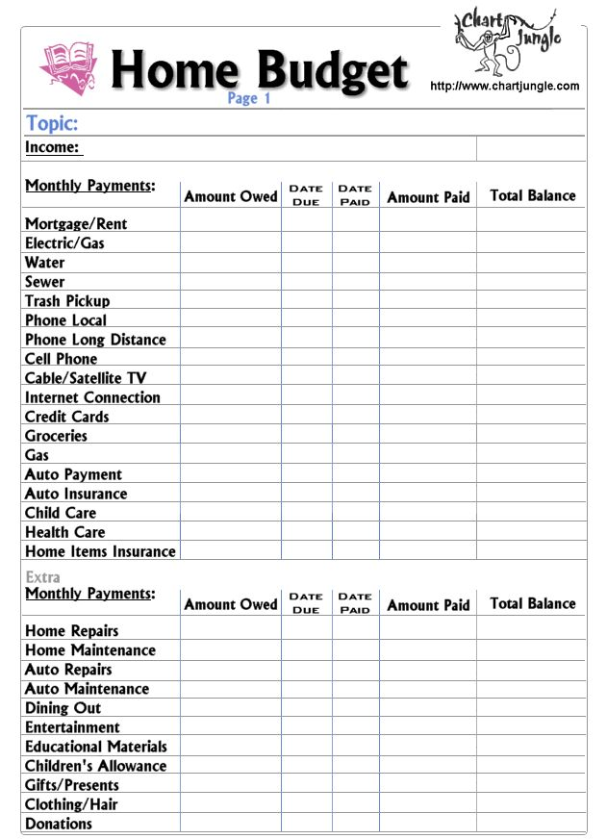
Example Budget

Slide 8
RISK MANAGEMNT
FIVE ELEMENTS OF RISK MANAGEMNT
WHY IS IT IMPORTANT
Notes:
1.Risk Identification, 2. Risk Analysis, 3.Assesment, 4. Intervention, 5.Monitoring risk Management.

Slide 9
Types Of Financial Risk Management
Investment Risk – Do Background Check before investment, invest with trusted area like banks etc..
Legal Risk – Legal risk is the risk of financial or reputational loss that can result from lack of awareness or misunderstanding of, ambiguity in, or reckless indifference
Growth risk - growth doesn't continue as expected.
- Credit Risk- the possibility of a loss resulting from a borrower's failure to repay a loan or meet contractual obligations.
- Natural Disaster - as the likelihood of loss of life, injury or destruction and damage from a disaster in a given period of time.
- Competitors - the potential for a business's competitors to prevent its growth and success

Slide 10
FIANNCIAL RISK
Pros
Cons
Can arise from uncontrollable or unpredictable outside forces
Risks can be difficult to overcome
Ability to spread and affect entire sectors or markets
Encourages more informed decisions
Helps assess value (risk-reward ratio)
Can be identified using analysis tools

Slide 11
Thank You

