Slide 1
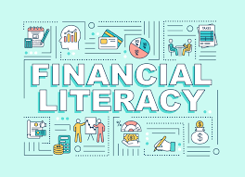

Slide 2
WHAT IS FINANCE LITERACY? Financial literacy is the ability to understand and effectively use various financial skills, including personal financial management, budgeting, and investing
WHY IT IS SO IMPORTANT?

Slide 3
BENEFITS OF FINANCIAL LITERACY
Financial literacy can prevent devastating. Mistakes: Financial literacy helps individuals avoid making mistakes with their personal finances
Financial literacy prepares people for emergencies: Prepares individuals ready for the uncertain.
Financial literacy can help individual reach their goals: by better understanding how to budget and save money, individuals can create plans that set expectations
Financial literacy invokes confidence:

Slide 4
WHAT Would WE Learn IN THIS Class
Art of Budgeting and planning
Choose your Dream
Money Saving
Buying a Home
Living on your Own
Consumer awareness

Slide 5
“CHOOSE YOUR GOALS” or DREAM BIG

Slide 6
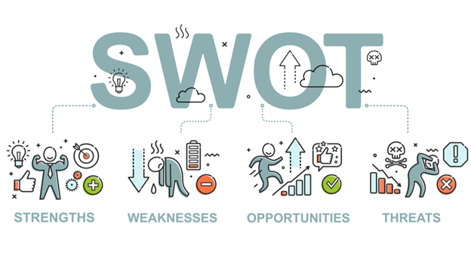

Slide 7
THANK YOU

