Slide 1
HOW TO BUILD SELF CONFIDENCE AND BOLDNESS

Slide 2
CONFIDENCE AND BOLDNESS ARE SAME ?

Slide 3
WHAT IS SELF -CONFIDENCE ?
If fear is holding you back from living the life you envision, courage exercises can help
Fear is a powerful force that feeds stagnation, and it prevents many of us from pursuing opportunities. People tend to get stuck within their comfort zones, like a self-made prison.
But there are things you can do to work your way out of it.

Slide 4
1. Identify what scares you
2. Describe your fears
3. Break out of your routine
4. Do something that makes you nervous
5. Pursue a bold act of courage
6. Connect with a mentor
7. Acknowledge your strengths
8. Embrace uncertainty
9. Practice vulnerability courage exercises
10. Celebrate every win, no matter how small!

Slide 5
Picture with Caption Layout
Fear in al its forms—from slight doubts to debilitating anxieties—can make you feel uncomfortable. But it can also reveal a lot of useful information.
In some ways, fear can be healthy. Fear triggers your nervous system and the survival instincts that keep you safe from real danger. For example, there are good reasons not to walk down a dark alley at night
Other kinds of fears are unhealthy. They can develop in response to trauma, stress, or negative experiences. If you go through a toxic relationship, for example, your fear may block you from trusting people and finding love again.
Many people fear not having enough, living with a scarcity mindset instead of an abundance mindset.
Fears can also reveal your core values and beliefs. You may feel afraid to start your dream company because you might fail. You get scared of public speaking because you might make a mistake. These fears show us an opportunity for courage.

Slide 6
Exercise
For this exercise, make a list of every fear that you have.
By writing down your fears, you can identify which are healthy and which are holding you back from fully participating in your life. You can also reveal opportunities for growth, healing, and some goals that feel important, yet scare you.

Slide 7
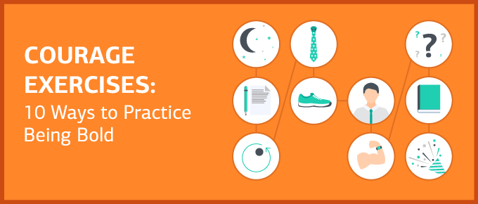
2.Describe your fears
published in Psychology Today found that putting your feelings into words helps curb negative responses to fear. Voicing your fear doesn’t make you weak — it makes you more brave.
Rather than denying your fear, or minimizing it, speak openly and share the fears that are holding you back.

Slide 8
Exercise
this courage exercise, take the time to express your fears in detail — first by writing them down, and then by speaking with a supportive friend, coach, or mentor.
By describing exactly what you are afraid of, you are empowering yourself to act with courage in the face of even your worst fears.

Slide 9
3. Break out of your routine
Having courage isn’t easy. So if you want to make big changes, start small.
It might sound silly, but science shows how small controlled steps can develop the courage muscle that you’ll need for bigger challenges.
Make a tiny change to experience something unfamiliar.
Change up a habitual pattern such as brushing teeth with the opposite hand, finding a new route to work for three days in a row, or ordering a totally unknown menu item.
Small changes to break out of a comfortable routine are a way to practice experiencing discomfort, without taking any real risk.

Slide 10
.
4. Do something that makes you nervous
When you let fear stop you from having fun, or expressing your individuality, it can add up to a life unlived. These are what I call medium-sized fears, the kind that lead you to avoid standing out, being seen, and connecting with people in an authentic way.

Slide 11
Exercise
Take a medium-sized risk. Find something that makes you nervous, and do it anyway.
Wear that funky outfit, bold neck-tie, or bright lipstick. Talk to someone you’d love to meet but haven’t found the nerve to approach. Take a weekend trip to a city you’ve never visited and do it solo.
Who knows the opportunities that will come your way?

Slide 12
5. Pursue a bold act of courage
Think of something big you’ve always wanted to do but felt too afraid, and begin steps to pursue it.
Because these are big moves, they are not accomplished in a single act. But you have to begin with the first step to put the whole thing in motion.
Here are some examples of how you might begin to pursue a big act of courage:
Hire a career coach and work toward a big promotion.
Find a competent therapist to begin healing from your most shame-based experiences or trauma.
Visit a personal trainer and start training to run that half-marathon.

Slide 13
8. Acknowledge your strengths
Researchers found that people who understand and develop their strengths feel happier and less depressed, even at times when nothing goes right. But beyond helping you feel better, understanding your strengths gives you a courage boost.
Learning how to identify your strengths is a key factor in personal and career development.
When you acknowledge your skills, you are far more confident in your ability to succeed — and more willing to go all-in on those big acts of courage.

Slide 14
8. Embrace uncertainty
Making big life changes can come with a lot of fear and uncertainty. Recognizing that uncertainty is part of the process, and not a reason to stop, can help you stay the course.
In William Bridges’ Transition Model, the time when you feel lost and unsure is called the Neutral Zone. It looks like this

Slide 15
Exercise
when things feel scary and uncertain, you can remind yourself that fear is natural and normal when navigating new situations. It doesn’t mean you have to turn back or give up.
With the right strategies to refocus your life, unstable emotions shift into feelings of confidence and accomplishment — eventually boosting your motivation and leading to success.

Slide 16
8.Practice vulnerability courage exercises

Slide 17
Do you blend in, conform, or hide your feelings out of fear of rejection?

