Slide 1
Importance of lifestyle
and nutrition in
women’s health care

Slide 2
Important Nutrients Every Woman Needs at Various Stages of Life
Nutrition plays a crucial role at every stage of a woman’s life.The nutritional needs of a woman are different from those of a man
because their bodies go through various changes during menstruation, pregnancy, breastfeeding and menopause.
Therefore, a balanced diet is essential to meet the daily recommended levels of nutrients to prevent common
nutritional deficiencies that can have an adverse impact on the health of a woman.
Adolescence(youth)
Adolescence is a crucial period as the nutrients requirement is high to support growth and development.
The vital nutrients for adolescent girls are iron, calcium and protein

Slide 3
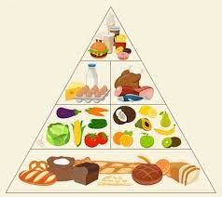
The Nutrition Source
Calcium
Iron
Iodine
Protein
Vitamin C
Zinc
Antioxidants

Slide 4
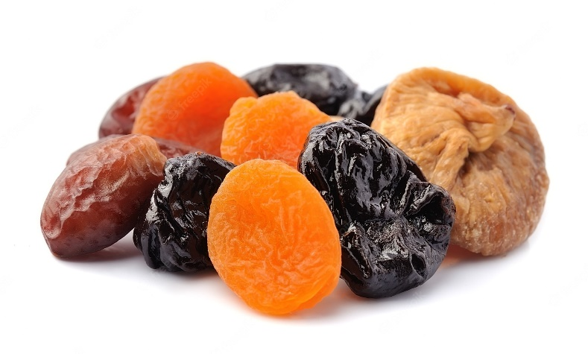
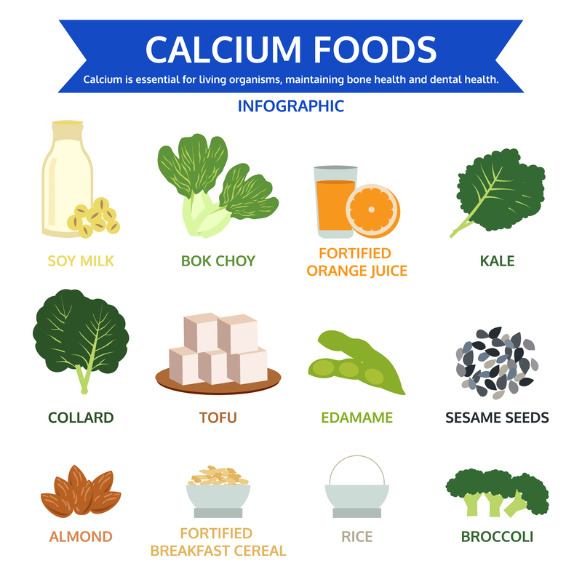
Calcium
Your body needs calcium to build and maintain strong bones. Your heart, muscles and nerves also need calcium to function properly. Some studies suggest that calcium, along with vitamin D, may have benefits beyond bone health: protecting against cancer, Strengthens teeth, Supports heart health. diabetes and high blood pressure.
side effects can sometimes occur, including gas, constipation and bloating.
food- milk, yogurt, pineapples, green leafy vegetable mathi fish, Dried apricots, figs, dates and prunes

Slide 5
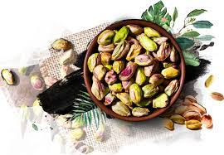
Iron
it helps reduce tiredness and fatigue, as well as playing an important role in normal energy metabolism, oxygen transport, cognitive function, immune function and formation of red blood cells
Too much iron can increase the risk of liver cancer and diabetes.
Red meat, pork , Pumpkin Juice, Green cabbage, Spinach, Peas, Pistachio nuts

Slide 6
Iodine
Iodine is needed to make the thyroid hormones thyroxine and triiodothyronine, which assist with the creation of proteins and enzyme activity, as well as regulating normal metabolism.
iodine is used to prevent and treat infections that may occur in minor scrapes and cuts. It works by killing bacteria that can cause infections. iodine intakes can also cause thyroid gland inflammation and thyroid cancer.
Seaweed ,Fish ,shellfish
Dairy (milk , cheese,ygurt),eggs,Beef liver
Chicken

Slide 7
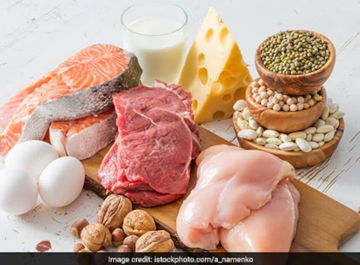
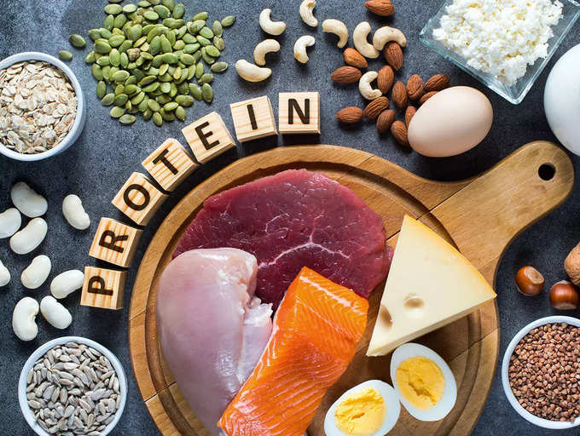
Protein
It provides the basic material for connective tissue, bones, hair, and nails. Bone health and density are essential for women, especially as they age. Getting enough protein can keep bones strong and minimize the density loss that comes with aging. It also keeps hair and nails looking healthy and strong.
Weakness, Fatigue ,Muscle wasting, also known as muscle atrophy ,Thinning hair ,Brittle nails ,Flaky skin
Severe protein deficiency can cause serious health problems, like:
Stomach bloating, Liver failure, Skin that splits open
Stunted growth ,Porous bones that are weak and thin
plant sources, such as soy, nuts, seeds, beans and lentils;
lean meats, such as skinless, white-meat chicken or turkey; a variety of fish or seafood; egg whites; or low-fat dairy.

Slide 8
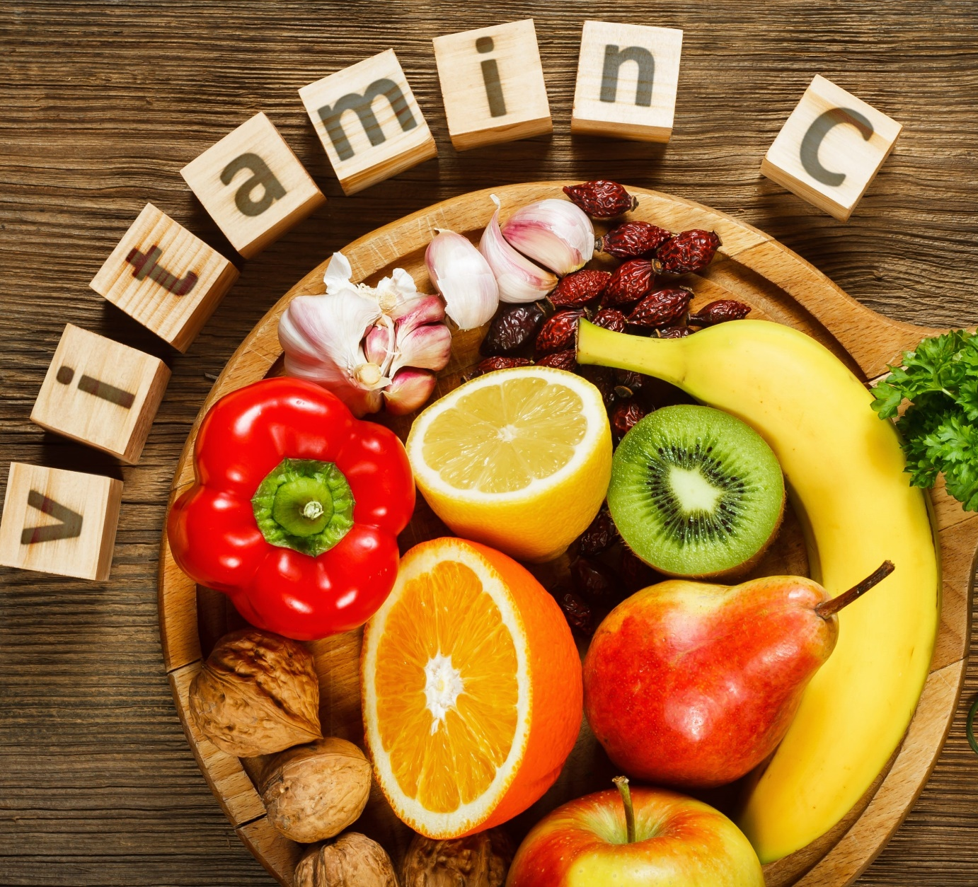
Vitamin C
Vitamin C helping to protect cells and keeping them healthy. maintaining healthy skin, blood vessels, bones and cartilage. helping with wound healing, vitamin C is also vital to your body's healing process. protection against immune system deficiencies, cardiovascular disease, prenatal health problems, eye disease, and even skin wrinkling.
side effects sickness, vomiting, heartburn, and esophagitis stomach cramps, diarrhea

Slide 9
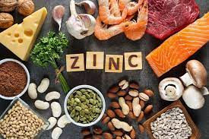
Zinc
It is needed for the body's defensive (immune) system to properly work. It plays a role in cell division, cell growth, wound healing, and the breakdown of carbohydrates. Zinc is also needed for the senses of smell and taste
beans, nuts, crab, lobster, whole grains, breakfast cereals, and dairy products.
Indigestion.
Diarrhea.
Headache.
Nausea.
Vomiting.

Slide 10
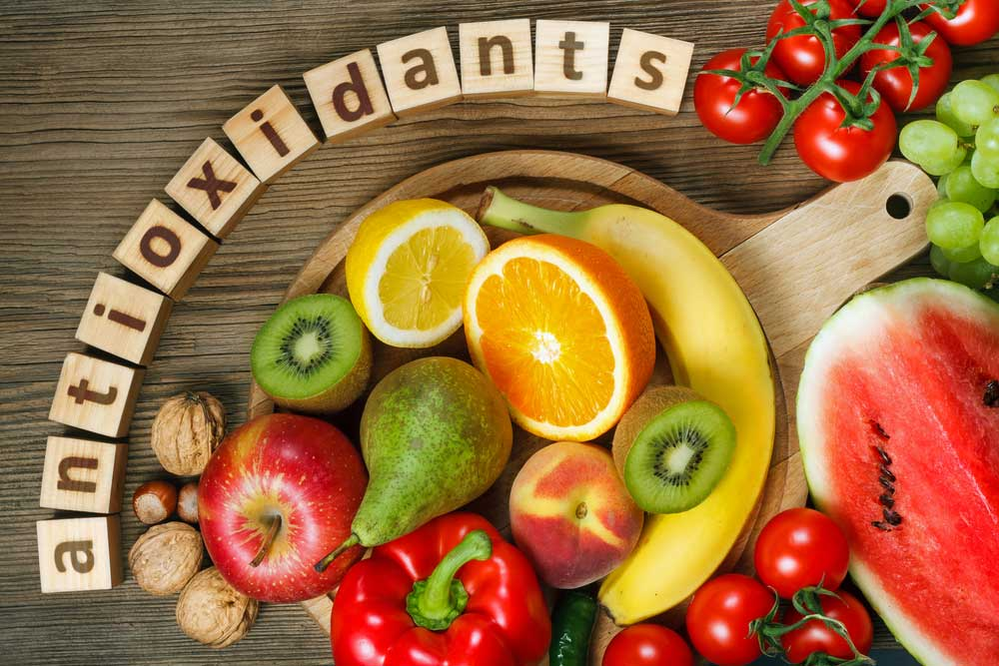
Antioxidants
Antioxidants are substances that may protect your cells against free radicals, which may play a role in heart disease, cancer and other diseases. Free radicals are molecules produced when your body breaks down food or when you're exposed to tobacco smoke or radiation.
Supplementing with high doses of beta-carotene may increase the risk of lung cancer in smokers.
Blueberries, cranberries, strawberries, blackberries, raspberries,

Slide 11
Dieting affects your health and mental state
Women who diet frequently are more likely to:
engage in binge eating
purge food (vomit) or misuse laxatives
restrict food intake and not get the nutrients they require for good health
over-exercise
have poor physical health
become depressed or anxious
become preoccupied with food
develop an eating disorder.

Slide 12
Thank you

