Slide 1
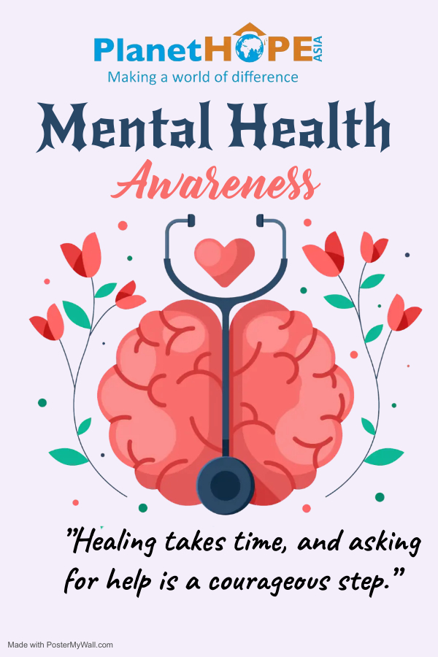

Slide 2
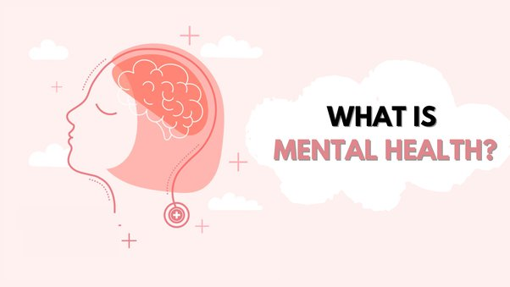

Slide 3
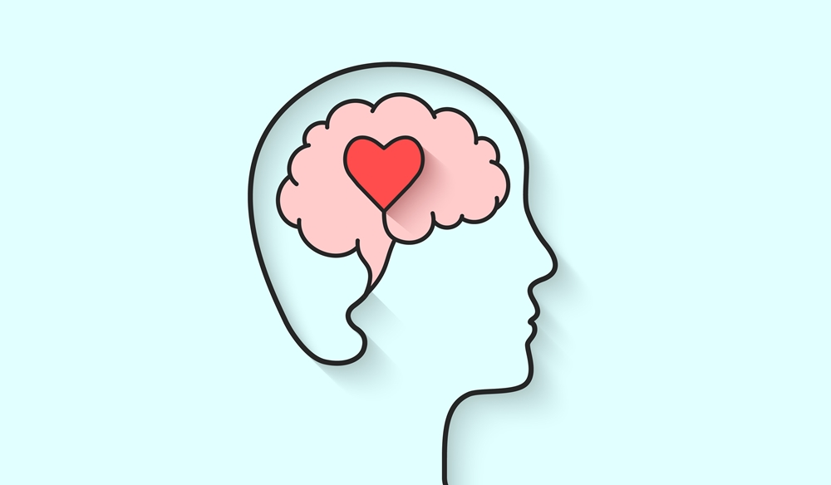
Mental health includes our emotional, psychological, and social well-being. It affects how we think, feel, and act. It also helps determine how we handle stress, relate to others, and make healthy choices. Mental health is important at every stage of life, from childhood and adolescence through adulthood.

Slide 4
What does it mean to have good mental health?
Mental health really means the state of your emotional wellbeing, which affects how you think, feel and behave. Having good mental health means more than just not having a mental health disorder; it means that you are able to make the most of your life, reach your potential and cope with the ups and downs of life. Mental health is just as important as physical health for living a happy, healthy and well-rounded life.
Other factors, such as difficult life experiences, can really affect our mental health and cause more serious issues. For example, poor mental health is associated with job losses, relationship problems, stressful work conditions, gender discrimination and many more factors. It is important we have access to help and support for our mental health when we need it.
More research into mental health is being conducted and it is becoming more important than ever to ensure that you are looking after your mental wellbeing in the same way you would take care of your physical health

Slide 5
What is the difference between mental health and mental wellbeing?

Slide 6
Now we've answered the question 'what does mental health mean?', let's address the difference between mental health and mental wellbeing. Mental wellbeing concerns your thoughts and feelings, and how you manage the ups and downs of daily life.
While mental wellbeing is not the same thing as mental health, the two things do influence one another
Prolonged periods of low mental wellbeing can cause mental health conditions like anxiety and depression to develop.
People who suffer from mental health conditions may experience low mental wellbeing frequently, although there will still be periods when they can maintain good mental wellbeing.

Slide 7
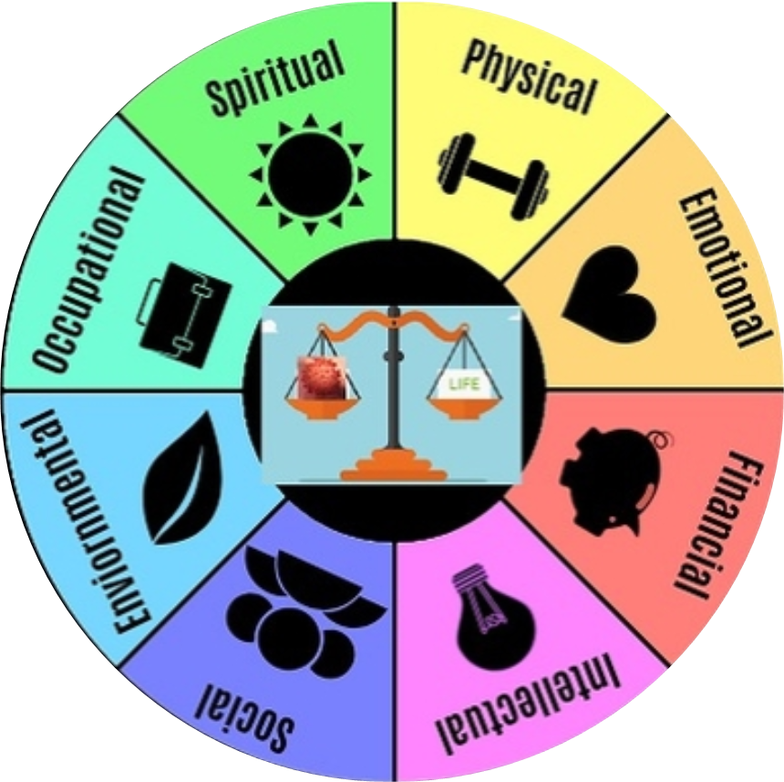
How do you balance your wellness?
Physical wellness involves eating a healthy diet, getting enough sleep, doing enough regular physical activity and preventing and managing illness and health conditions. Not being physically healthy can lead to numerous health problems or diseases

Slide 8
What are the characteristics of good mental wellbeing?
It’s important to clarify that good mental wellbeing does not mean the absence of negative thoughts and emotions. Feelings like anger, sadness, overwhelm and a range of other emotions may all still arise, but good mental wellbeing means you’re able to understand and deal with the feelings. Having good mental wellbeing means you:
are confident in yourself
build and maintain positive relationships with others
have a sense of meaning and purpose
live and work productively
manage the stresses of daily life
cope with change.

Slide 9
What can affect mental wellbeing?
Mental wellbeing is often impacted by events that are out of our control, for example:
Loss.
Trauma.
Social disadvantages.
Health conditions.
Stress.
Discrimination.
How we respond to such events can affect our mental wellbeing. Our habits may not be conducive to good mental wellbeing; for example, withdrawing instead of seeking support and fearing the worst rather than remaining open to different possibilities can both have a negative impact on wellbeing. Developing good habits will improve mental wellbeing so that we are better prepared to face challenges when they arise.

Slide 10
How can you improve mental wellbeing?
Be Nice to Yourself
Exercise
Eat Healthy
Sleep Well
Put the Screens to Sleep Before You Go to Bed
Breathe Deep
Connect With Others
Write Down Ways to Relax
Find Support (and Be Supportive)
Take Small Steps
Learn a new skill
Be kind and give to others
Be present in the moment (mindfulness)

Slide 11
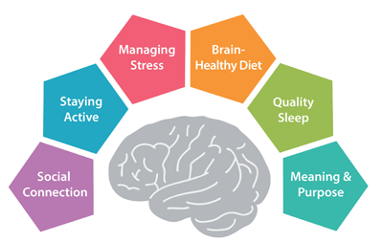
What are the benefits of positive mental health?
By having positive mental health, you can lead a much happier life by being more productive, more positive towards yourself and to others and enjoy increased levels of motivations for doing whatever it is that you love to do

Slide 12
What are the effects of poor mental health?

Slide 13
effects of poor mental health
Gender Differences
Rates of Mental Health Conditions
Research
Depression
PTSD
Anxiety
Suicide

Slide 14
Gender Differences in Mental Disorders Recent research has identified disparities between women and men in regard to risk, prevalence, presentation, course, and treatment of mental disorders.
Rates of Mental Health Conditions – Each year, 1 in 5 women in the United States has a mental health problem such as depression, post-traumatic stress disorder (PTSD), or an eating disorder.
5 Research – Although research shows that women and men have similar rates of mental health problems, the types of mental conditions may differ.6
Although research shows that women and men have similar rates of mental health problems, the types of mental conditions may differ.
6 Depression – The most common mental health problem in women is depression. Twice as many women experience depression in their lifetime than men. Approximately 1 in 9 women 18 and older have had at least one major depressive episode in the past year.
7 PTSD – Compared with men, women are twice as likely to experience PTSD. Women are more likely to have hypervigilance, feel depressed, and have trouble feeling emotions; men are more likely to feel angry and have problems with alcohol or drugs.
9 Anxiety – Women are twice as likely as men to experience generalized anxiety disorder or panic disorder.
9 Suicide – Women attempt suicide more often than men; however, men are four times more likely to die by suicide.10 Eating Disorders

Slide 15
