Slide 1
Promoting Civic Sense: Building a Better Community Together
By Shiny Vincent

Slide 2
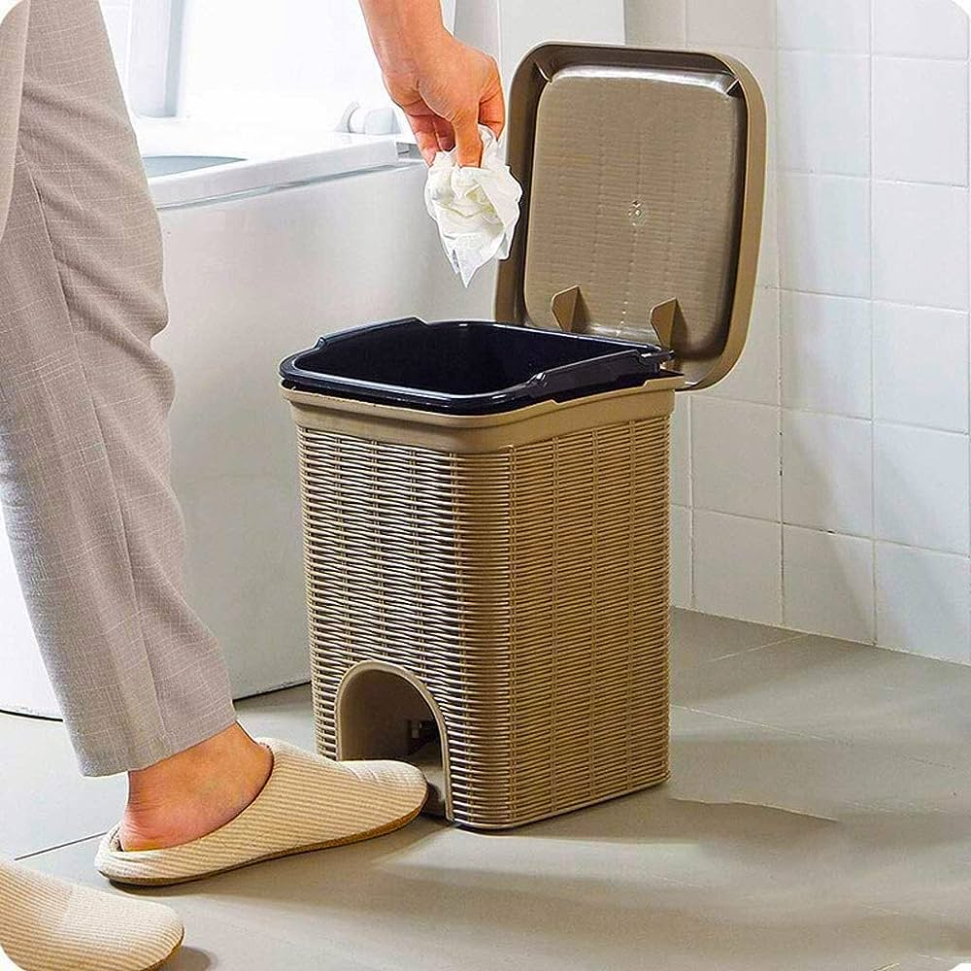
What is Civic Sense?
Civic sense is the responsible behavior and awareness of one's community and surroundings
civic sense involves respecting public spaces and promoting a sense of belonging.
.

Slide 3
Importance of Civic Sense
Enhances the Quality of Life
Think of your favorite park or playground. How much fun is it when it's clean and well-kept? Civic sense means making sure these public places are clean and nice for everyone to enjoy. When people take care of these places, it makes your community a better and more fun place to live.

Slide 4
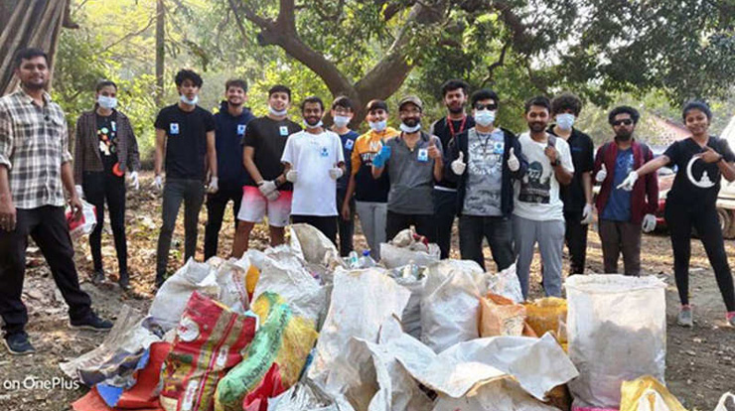
Builds a Sense of Community
Civic sense promotes a sense of belonging and togetherness within a community. When individuals take responsibility for their surroundings, it fosters a feeling of unity.

Slide 5
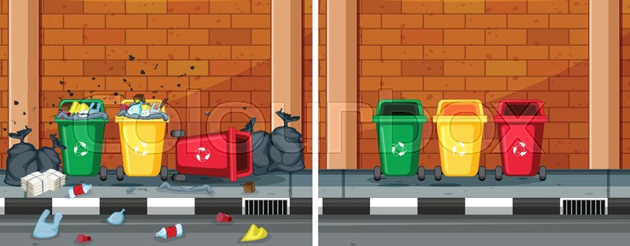
3. Reduces Pollution and Littering
Civic sense plays a crucial role in reducing pollution and littering. Responsible disposal of waste and proper maintenance of public spaces help keep the environment clean.
This not only benefits the community aesthetically but also reduces environmental damage and health hazards associated with pollution.

Slide 6
4. Creates Safer Communities
Civic sense contributes to safer neighborhoods. When people are engaged and aware of their surroundings, they are more likely to report suspicious activities and maintain security.
Well-lit streets, maintained sidewalks, and active community participation help deter crime and create a safer living environment.

Slide 7
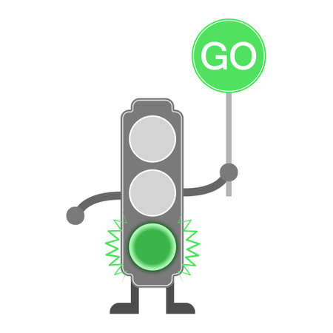
Enhanced Safety
Civic sense is like having traffic rules that keep us safe. When we follow these rules and be cautious, it reduces accidents and keeps us, our friends, and family safe. It's like a shield that protects us from harm on the road and in our neighborhoods.

Slide 8
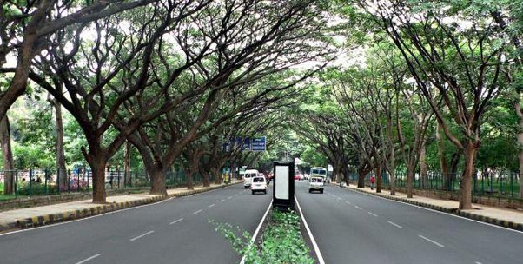
Better Infrastructure
Imagine civic sense as a magic wand that helps fix and maintain things like roads, buildings, and public facilities. When people care for these things and don't damage them, it means we have better and safer places to live, study, and play.

Slide 9
Hygiene and Sanitation
Think of civic sense like a guardian angel for our surroundings, just like we watch over our homes.
When we use dustbins and don't throw trash around, we're keeping our parks, streets, and public areas clean and healthy. This is like a protective shield against dirt and germs, creating a safer and more enjoyable place for our families and friends to spend time in.

Slide 10
Conclusion
In conclusion, civic sense is not just a concept; it's a powerful tool that can transform our communities and our lives.
By practicing good civic sense, we become stewards of our surroundings, enhancing our quality of life, building stronger bonds within our communities, and creating safer, more vibrant neighborhoods.
let's be the change-makers, the role models, and the community builders. Let's embrace civic sense as a way of life, not just for ourselves but for the betterment of our communities.

