Slide 1
hiv aids awareness and prevention
By kavya.kv

Slide 2
what is the difference between hiv and aids?

Slide 3
What HIV means?
HIV (human immunodeficiency virus) is a virus that attacks the body's immune system
What Is AIDS?
AIDS is the late stage of HIV infection that occurs when the body’s immune system
is badly damaged because of the virus.

Slide 4
How Do I Know If I Have HIV?
The only way to know for sure if you have HIV is to get tested. Testing is relatively simple. You can ask your health care provider for an HIV test. Many medical clinics, substance abuse programs, community health centers, and hospitals offer them too.
HIV self-testing is also an option. Self-testing allows people to take an HIV test and find out their result in their own home or other private location. You can buy a self-test kit at a pharmacy or online. Some health departments or community-based organizations also provide self-test kits for a reduced cost or for free.

Slide 5
How is HIV caused?
HIV is caused by a virus. It can spread through sexual contact, illicit injection drug use or sharing needles, contact with infected blood, or from mother to child during pregnancy, childbirth or breastfeeding.
HIV destroys CD4 T cells — white blood cells that play a large role in helping your body fight disease
The human body can’t get rid of HIV and no effective HIV cure exists. So, once you have HIV, you have it for life.

Slide 7
What Should I Do If I Think I’m At Risk for HIV?
If you think you’re at risk for getting HIV, or that you might already have HIV, get tested and learn about the effective HIV prevention and treatment options available today.
Testing is the only way to know for sure if you have HIV. Find out whether testing is recommended for you.
Many HIV tests are now quick, free, and painless. Ask your health care provider for an HIV test or use the HIV Services Locator to find a testing site near you. You can also buy an FDA-approved home testing kit at a pharmacy or online.
Knowing your HIV status gives you powerful information to help you take steps to keep you and your partner(s) healthy:
If you test positive, you can start HIV treatment to stay healthy and prevent transmitting HIV to others.
If you test negative, you can use HIV prevention tools to reduce your risk of getting HIV in the future.

Slide 8
What Are the Symptoms of HIV?
There are several symptoms of HIV. Not everyone will have the same symptoms. It depends on the person and what stage of the disease they are in.
Below are the three stages of HIV and some of the symptoms people may experience.
Stage 1: Acute HIV Infection
Stage 2: Clinical Latency
Stage 3: AIDS

Slide 9
Acute HIV Infection
Within 2 to 4 weeks after infection with HIV, about two-thirds of people will have a flu-like illness. This is the body’s natural response to HIV infection.
Flu-like symptoms can include:
Fever
Chills
Rash
Night sweats
Muscle aches
Sore throat
Fatigue
Swollen lymph nodes
Mouth ulcers
These symptoms can last anywhere from a few days to several weeks. But some people do not have any symptoms at all during this early stage of HIV.

Slide 10
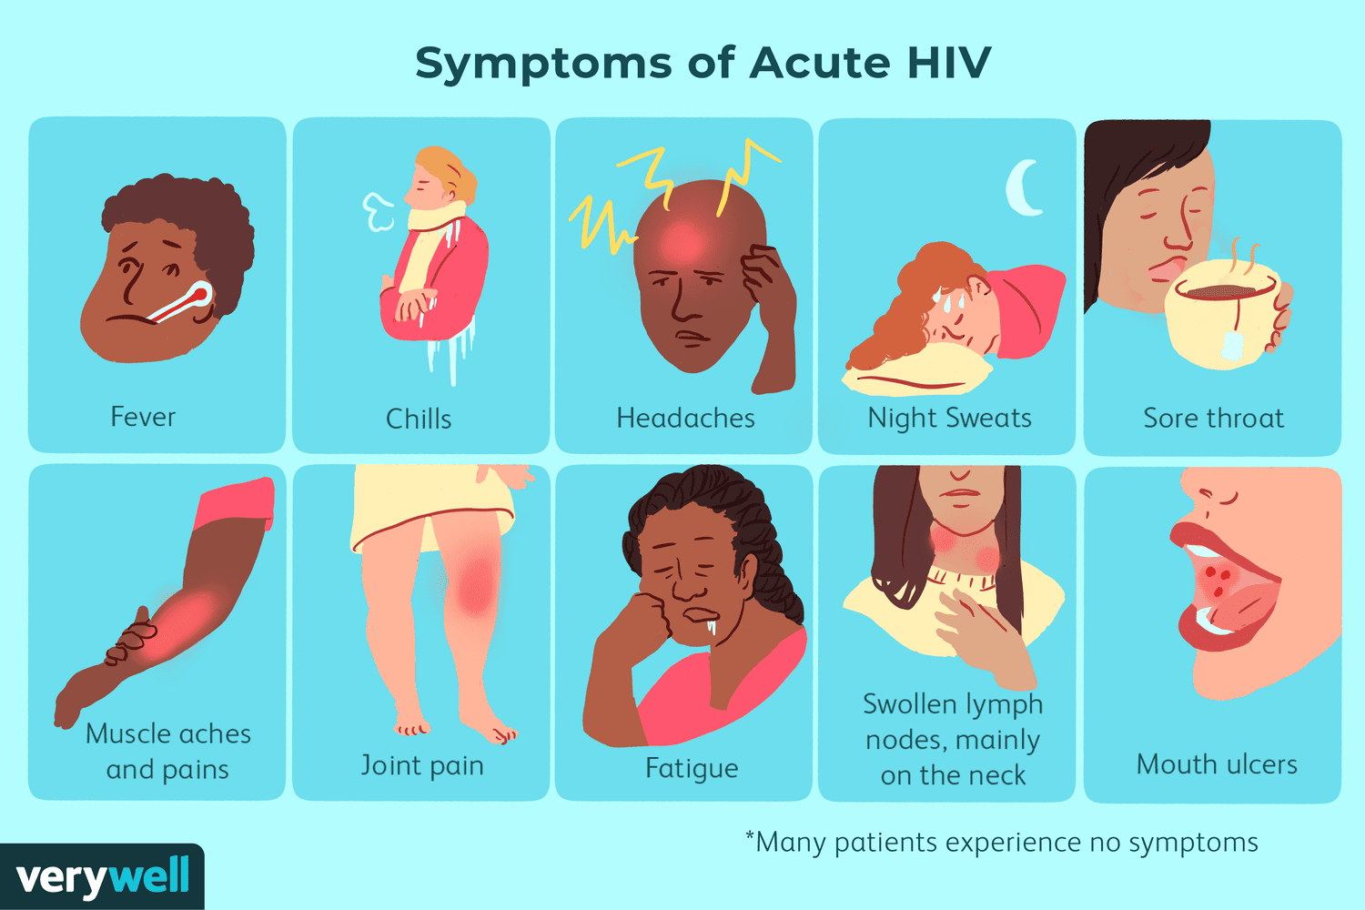

Slide 11
Clinical Latency
In this stage, the virus still multiplies, but at very low levels. People in this stage may not feel sick or have any symptoms. This stage is also called chronic HIV infection.
Without HIV treatment, people can stay in this stage for 10 or 15 years, but some move through this stage faster.
If you take HIV medicine exactly as prescribed and get and keep an undetectable viral load, you can live and long and healthy life and will not transmit HIV to your HIV-negative partners through sex.
But if your viral load is detectable, you can transmit HIV during this stage, even when you have no symptoms. It’s important to see your health care provider regularly to get your viral load checked.

Slide 12
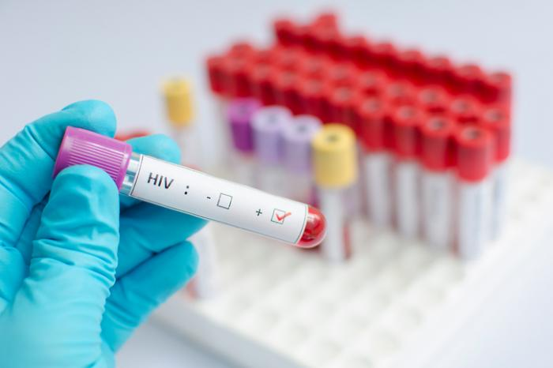
Don’t assume you have HIV just because you have any of these symptoms—they can be similar to those caused by other illnesses. But if you think you may have been exposed to HIV, get an HIV test.

Slide 13
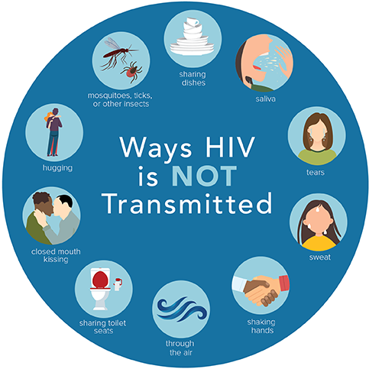

Slide 15
AIDS Symptoms
The final stage of an HIV infection is AIDS, which occurs when the immune system is severely damaged.
Rapid weight loss.
Recurring fever.
Profuse night sweats.
Pronounced fatigue and weakness.
Prolonged swollen lymph glands.
Chronic diarrhea, which lasts more than a week.
Sores that develop in the mucous membranes of the mouth, anus, or genitals
Blotches (red, brown, pink, or purplish) on the skin, under the skin, or inside the mouth, nose, or eyelids
Neurological issues, including memory loss and depression
Many of these symptoms, particularly those that are severe, may be related to other opportunistic infections that develop due to the weakened immune system.
HIV ಗೆ ಯಾವುದೇ ಚಿಕಿತ್ಸೆ ಇಲ್ಲ, ಆದರೆ ನೀವು
HIV ಚಿಕಿತ್ಸೆಯಿಂದ ಅದನ್ನು ನಿಯಂತ್ರಿಸಬಹುದು.
ಹೆಚ್ಚಿನ ಜನರು ಆರು ತಿಂಗಳೊಳಗೆ ವೈರಸ್ನಿಯಂತ್ರಣಕ್ಕೆ ಬರಬಹುದು. HIV ಚಿಕಿತ್ಸೆಯು ಇತರಲೈಂಗಿಕವಾಗಿ ಹರಡುವ ರೋಗಗಳ ಹರಡುವಿಕೆಯನ್ನು ತಡೆಯುವುದಿಲ್ಲ

Slide 16
Thank you

