Slide 1
Media Analysis & Critical Thinking Module 4

Slide 2
Definition: Media analysis means looking really closely at things like news, TV shows, movies, and ads to understand what they're saying and why.
Purpose: It helps us figure out if there's a hidden message or if they're trying to make us think or feel a certain way.

Slide 3
Definition: Critical thinking is like superhero thinking! It's about using our brains to really understand things and make good decisions.
Superpowers: It helps us be super smart detectives, figuring out what's true and what's just pretend.
11/24/2023 12:36 PM
3

Slide 4
Decoding media messgaes
Meaning and Definition:
The process of interpreting or understanding the meaning behind messages conveyed through various forms of media.
Information, ideas, or content transmitted through mediums such as television, radio, print, social media, etc.
11/24/2023 12:36 PM
4

Slide 5
Activity / Assignment
Decoding Session (20 minutes):Have each group present one advertisement or article.
Discuss as a class the messages portrayed and how they might impact the audience.
Encourage questions like "What is the main message? Who is the target audience? What emotions or ideas are being conveyed?"
11/24/2023 12:36 PM
5

Slide 6
Identifying Bias and Framing
Bias:
Bias is when someone has a preference or prejudice for or against something, someone, or a group of people. It can affect how they think and make decisions.
11/24/2023 12:36 PM
6

Slide 7
Framming
Framing is how information is presented or "framed" to influence people's perceptions. The way something is said or shown can affect how people understand and react to it.

Slide 8
Activities to Understand Framing:
Activities to Understand Bias:
News Headline Exercise:
Show different headlines for the same news story but with different framings.
Discuss how the choice of words and emphasis can shape the way people perceive the news.
Role Play:
Create scenarios where characters have different opinions or biases. Example : a debate with a trending topic about Bangalore.
Ask the students to act out the scenarios and discuss how biases can impact communication and decision-making.
11/24/2023 12:36 PM
8

Slide 9
Evaluating News and Information Sources
Evaluation meaning
Key Criteria for Evaluation:
Evaluating news and information sources is the process of critically assessing the credibility, reliability, and accuracy of the information presented in various media outlets.
Source Credibility:
Who created the information, and what are their qualifications?
Is the source known for its accuracy and reliability?
Evidence and Documentation:
Does the information provide verifiable evidence and references?
Are there citations or links to reputable sources?

Slide 10
Contd…
Timeliness:
How recent is the information?
Does the timeliness of the information affect its relevance?
Consistency:
Does the information align with other reputable sources?
Are there contradictions within the information itself?
11/24/2023 12:36 PM
10

Slide 11
Activities…
Individual Activity (20 minutes):
Distribute a mix of news articles to students.
Provide the evaluation criteria checklist and ask them to assess their assigned article.
Group Discussion (15 minutes):
Have students discuss their findings in small groups.
Encourage them to compare evaluations and reach a consensus on the credibility of their articles.
11/24/2023 12:36 PM
11

Slide 12
Fact-Checking and Information Verification
Key Aspects:
Accuracy: Assess the correctness of information.
Source Reliability: Evaluate the credibility of the information source.
Bias Awareness: Recognize potential biases that may affect the information.
Contextual Understanding: Consider the context in which information is presented.
Cross-Verification: Verify information using multiple sources.
Fact-checking and information verification are critical skills in media analysis and critical thinking. It involves assessing the accuracy, reliability, and credibility of news and information sources.
11/24/2023 12:36 PM
12

Slide 13
Accuracy:
Assess the correctness of information.
Definition: Accuracy refers to the correctness of information. It involves verifying whether the details presented are true and supported by evidence.
Process: To assess accuracy, individuals can cross-reference information with established facts, historical records, scientific studies, or expert opinions.
Example: If a news article claims that a specific event occurred on a particular date, fact-checking involves verifying the date using reliable historical records or multiple reputable sources.

Slide 14
Source Reliability: Evaluate the credibility of the information source.
Process: Check the credentials of the author or organization, look for affiliations or potential conflicts of interest, and assess whether the source has a history of providing accurate and unbiased information.
Example: If a health claim is made in an article, assessing source reliability involves checking if the information comes from a reputable medical institution or has been reviewed by experts in the field.
Definition: Source reliability assesses the trustworthiness of the provider of information. It involves considering the reputation, expertise, and objectivity of the source.

Slide 15
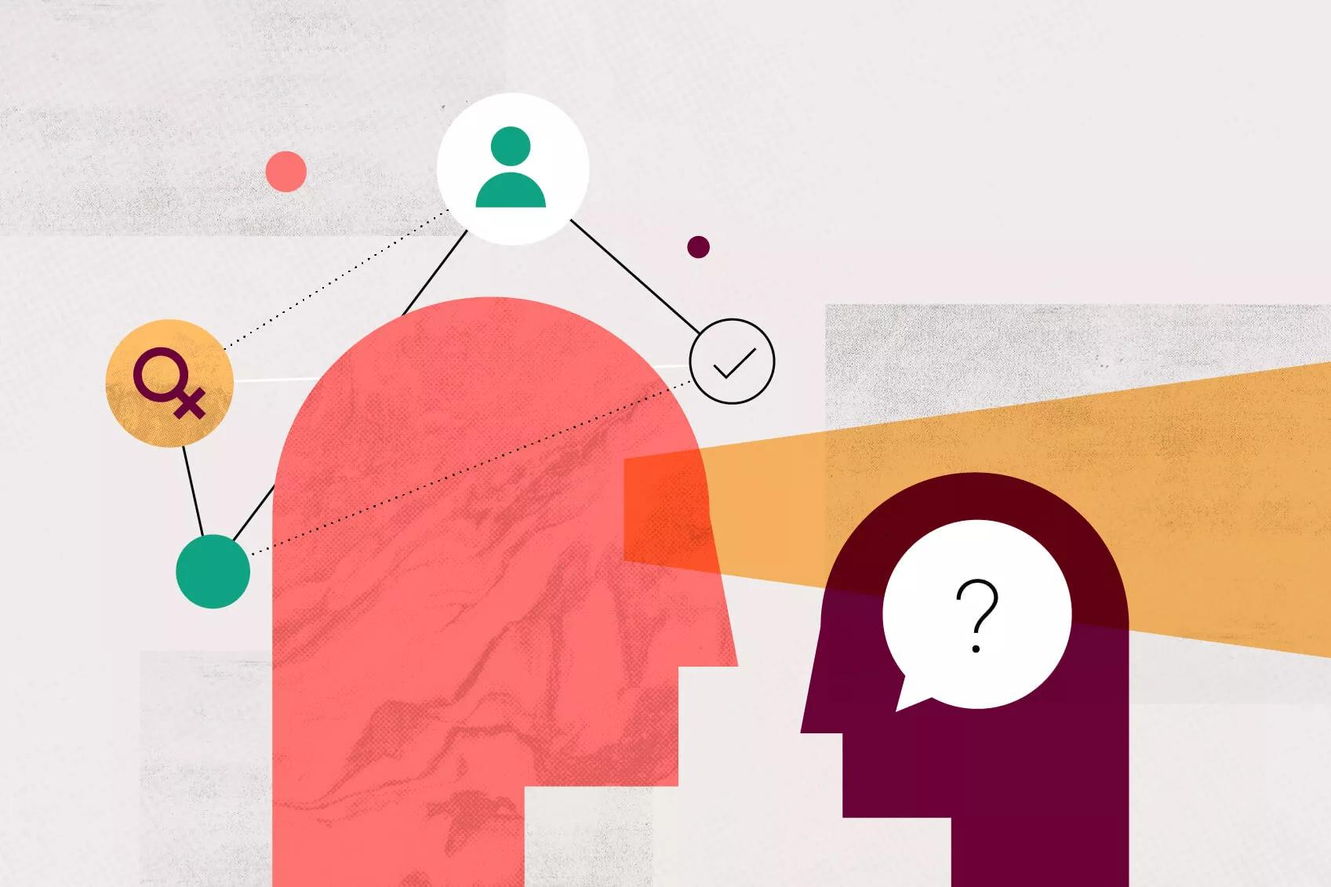
Bias Awareness: Recognize potential biases that may affect the information.
Definition: Bias awareness involves acknowledging and understanding the potential prejudices or preferences that may influence the way information is presented.
Process: Be alert to language choices, framing of issues, and the omission or inclusion of certain details. Consider how the information might be influenced by political, cultural, or personal biases.
Example: In a news article discussing a controversial topic, bias awareness involves recognizing if the language used favors a particular viewpoint and considering alternative perspectives.

Slide 16
Contextual Understanding: Consider the context in which information is presented.
Contextual understanding involves taking into account the circumstances, conditions, or setting in which information is presented to avoid misinterpretation.
Process: Consider the background, timing, and surrounding circumstances to grasp the full meaning of information. Be wary of cherry-picked facts taken out of context.
Example: A quote from a public figure might seem controversial when taken out of context. Contextual understanding requires considering the full statement and the situation in which it was made.

Slide 17
Cross-Verification: Verify information using multiple sources.
Definition: Cross-verification entails confirming information by checking it against multiple independent and reliable sources.
Process: Relying on diverse sources helps ensure that information is not skewed or manipulated. Consistency across multiple sources increases confidence in the accuracy of the information.
Example: When verifying a breaking news story, cross-verification involves checking multiple news outlets to confirm the details and ensure that the information is not a result of a single source's error or bias.

Slide 18
"Reliable Reporter Challenge"
Objective: Enhance students' ability to verify information using multiple sources.
Materials:
A list of news articles or statements (print or online) with varying degrees of reliability and accuracy.
Access to multiple news websites or reputable sources.
Procedure:
Introduction (10 mins):
Discuss the importance of cross-verification in ensuring the accuracy of information.
Briefly explain the activity and the goal of becoming a "Reliable Reporter."
Group Formation (5 mins):
Divide students into small groups.
Distribute Information (15 mins):
Provide each group with a list of news articles or statements. Some should be accurate and reliable, while others may contain errors or biases.
Cross-Verification Task (20 mins):
Instruct each group to cross-verify the information by checking multiple reputable sources. Encourage them to use a variety of news websites, fact-checking organizations, and other reliable platforms.

Slide 19
Source Reliability Scavenger Hunt
Objective: Develop students' skills in evaluating the credibility of information sources.
Materials:
A list of various sources (online and offline) such as websites, articles, blogs, and social media posts.
Criteria for assessing reliability (e.g., authorship, publication date, references, expertise).
Worksheets or a document for students to record their findings.
Procedure:
Introduction (15 mins):
Discuss the importance of reliable information and how the credibility of the source can impact the accuracy of the information.
Introduce the criteria for assessing source reliability, such as authorship, publication date, references, and expertise.

Slide 20
Explanation (15 mins):
Review each criterion with examples. Emphasize the significance of these factors in determining the reliability of a source.
Source Scavenger Hunt (30 mins):
Provide the list of sources to each student or group.
Ask students to investigate each source on the list and evaluate its reliability based on the given criteria.
Encourage them to use the internet or library resources to gather information about the sources.
Analysis and Discussion (20 mins):
After the scavenger hunt, have students share their findings.
Discuss as a class which sources were deemed reliable and why, and which were considered less credible.
Emphasize the importance of consensus and critical thinking in evaluating source reliability.

Slide 21
Media Analysis & Critical Thinking is important in digital media literacy because..
Abundance of Information: In the digital age, there's an overflow of information online.
Complex Landscape: The online world is intricate and diverse, making it challenging to navigate.
Empowerment: Media analysis and critical thinking empower individuals to make sense of this vast digital landscape.
Discern Credibility: These skills help people distinguish between reliable and unreliable sources of information.
Identify Bias: Critical thinking enables the recognition of potential biases in media content.

Slide 22
Identify Bias: Critical thinking enables the recognition of potential biases in media content.
Ensure Accuracy: Individuals can assess and ensure the accuracy of information they encounter online.
Responsible Citizenship: In a world of rapid information spread, these skills are vital for responsible digital citizenship.
Informed Decision-Making: Critical evaluation promotes informed decision-making in the digital realm.

