Slide 1
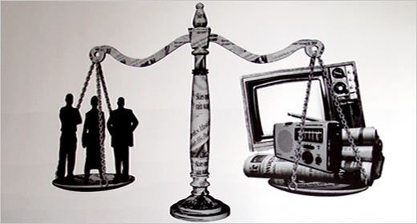
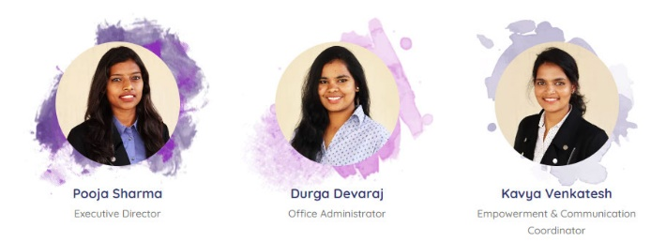
Media Ethics & responsibility Module 5

Slide 2
Meaning and definition
Media ethics refers to the principles and standards that guide responsible behavior in the creation, distribution, and consumption of media content. It involves making ethical decisions about what information to share, how to present it, and the impact it may have on individuals and society.

Slide 3
Responsibility in Digital Media
Responsibility in digital media involves understanding the consequences of one's actions online and being accountable for the content shared. It includes respecting others' rights, avoiding harm, and using digital platforms in a positive and constructive manner.
Activity: Discuss cyberbullying and its negative impact on individuals.
11/24/2023 12:35 PM
3

Slide 4
Evaluating digital media content
Teaching students how to critically evaluate digital media content helps them develop the skills to distinguish between credible and unreliable sources. This includes understanding bias, fact-checking, and recognizing misinformation.
11/24/2023 12:35 PM
4

Slide 5
Practical Activity
Instructions:
Divide the students into small groups.
Provide them with scenarios related to digital media use (e.g., sharing a photo online, commenting on social media, forwarding a message).
Ask each group to discuss the ethical considerations and responsibilities involved in the given scenario.
Have each group create a digital media code of conduct that outlines principles for responsible online behavior.
Encourage creativity and critical thinking in their code of conduct.
Presentation: Each group presents their digital media code of conduct to the class, explaining the principles they included and why they are important. This encourages discussion and allows students to learn from each other's perspectives.
11/24/2023 12:35 PM
5

Slide 6
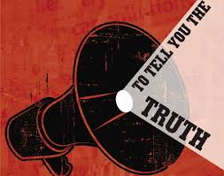
Ethical considerations in media
Introduction to digital media
Digital media ethics refers to the principles and guidelines that govern the responsible creation and consumption of digital content. It involves considering the impact of media on individuals, communities, and society as a whole.
Activity :Have students create a simple collage representing positive and negative aspects of digital media, discussing their choices in class.
11/24/2023 12:35 PM
6

Slide 7
Copyright and Fair Use
Copyright protects the original work of creators. Fair use allows limited use of copyrighted material without permission for purposes like education, commentary, or parody.
11/24/2023 12:35 PM
7

Slide 8
Privacy in Digital Media
Privacy means keeping your personal information safe when you use digital devices like computers, phones, or the internet. It's like having a secret box for your personal stuff, and you want to make sure that only the people you trust can see what's inside.
Activity:
Ask students to create a set of guidelines for using social media responsibly, focusing on privacy concerns.

Slide 9
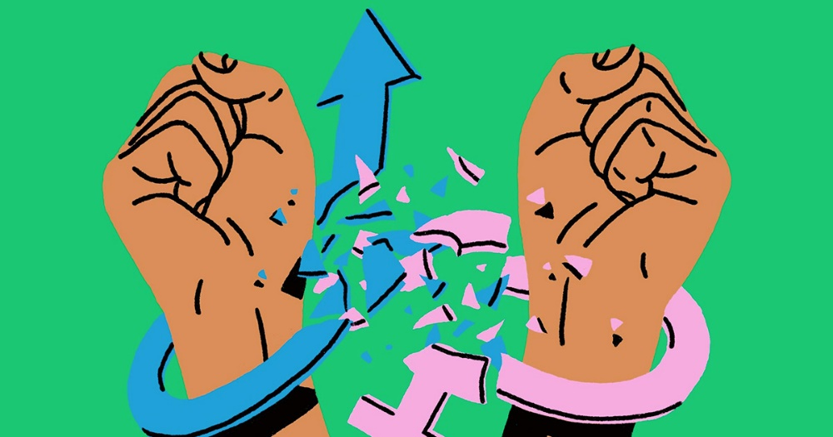
Media Representation and Stereotypes
When we talk about "examining how different groups are represented in media," we mean looking at how movies, TV shows, advertisements, and other things we see on screens show different kinds of people—like boys and girls, people from different countries, or those with different abilities.
Practical Activity:
Have students create a short video or a role play challenging stereotypes and promoting positive representation.
For example, if a movie always shows boys as strong and girls as only interested in certain things, it might make people think that's how all boys and girls are, which isn't true.
11/24/2023 12:35 PM
9

Slide 10
Digital Literacy and Fake News
Understanding Fake News
Fake news is like a tricky prank played on the internet. It's information that's not true but looks real. We need to be detectives to spot it.
Examples:
Imagine someone telling a made-up story about your favorite superhero. It might sound fun, but it can confuse people and cause problems.
.
Practical Activity:
Play a "Spot the Fake" game where students learn to identify real and fake news articles.
11/24/2023 12:35 PM
10

Slide 11
Consequences of Fake News
When fake news spreads, it can be like a game of broken telephone. The wrong information goes from one person to another, and everyone gets confused.
Activity:Share stories about how fake news caused confusion or made people believe things that weren't true.

Slide 12
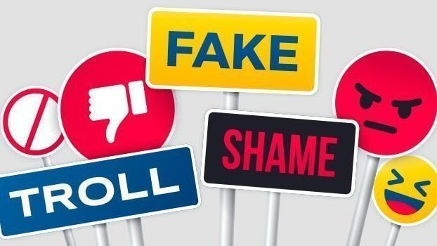
Countering Online Harassment and Misinformation
Online harassment refers to the intentional use of digital platforms to threaten, intimidate, or harm others emotionally or socially
Examples: Cyberbullying, hate speech, spreading rumors.
11/24/2023 12:35 PM
12

Slide 13
Recognizing Harassment
Activity
Present relatable scenarios and ask students to discuss whether they perceive it as online harassment or not.
Encourage open conversations about different perspectives and experiences.

Slide 14
Combatting Online Harassment
Building Empathy and Respect Online
Discuss the importance of treating others online with the same respect as offline.
Role-play scenarios where students demonstrate respectful online communication.
Objective: Equip students with strategies to counteract online harassment and promote a positive digital environment.
Reporting and Blocking
Teach students how to report and block individuals engaging in harassment.
Provide step-by-step guides for popular social media platforms.
Digital Etiquette
Emphasize the significance of maintaining good digital etiquette.
Create a class "Digital Etiquette Pledge" where students commit to positive online behavior.

Slide 15
Activity
Organize a class event where students present their understanding of online harassment and misinformation.
Students can create posters, short videos, or presentations showcasing what they've learned and share practical tips for responsible online behavior.
Invite parents and other classes to attend the showcase, fostering a school-wide commitment to digital citizenship.

Slide 16
Importance of ethics in digital media
Credibility and Trustworthiness
Protection of Individuals and Groups:
Prevents the spread of misinformation and the potential harm it can cause to individuals and communities.
Safeguards against the negative impact of false narratives or biased reporting.
Upholds the credibility of digital media by ensuring accurate and reliable information.
Fosters trust between media outlets and their audiences.

Slide 17
respect for Privacy:
Social Harmony and Inclusivity
Upholds individuals' right to privacy by avoiding the unauthorized disclosure of personal information.
Protects against the misuse of data and ensures responsible handling of sensitive issues.
Contributes to social harmony by avoiding content that may incite hatred, discrimination, or violence.
Promotes inclusivity by representing diverse perspectives and communities fairly.

Slide 18
Media ethics ensures the reliability of information, fostering trust between media outlets and their audiences.

