Slide 1
Digital Media literacy syllabus

Slide 2
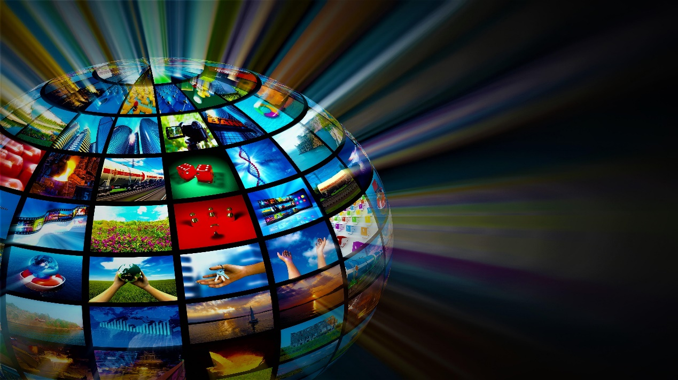
Understanding Digital Media Objectives: 1.Define Digital Media 2.Explain the characteristics of digital media 3.Explore the impact of digital media on society
11/24/2023 12:38 PM
2

Slide 3
Text area
Characteristics of Digital Media:
*Interactivity: Digital media allows users to engage with content, such as clicking on links, commenting, and sharing.
*Accessibility: Content can be accessed from anywhere with an internet connection, making it highly convenient.
*Scalability: Digital media can easily reach a large audience or be personalized for individual users.
*Multimodality: It combines various forms of media, like text, images, audio, and video, often within a single platform or piece of content.
*Persistence: Digital media content can exist and be accessed for an extended period, unlike traditional media that may have limited shelf life.
11/24/2023 12:38 PM
3

Slide 4
Explore the Impact of Digital Media on Society
Positive Impacts:
Information Access: Digital media provides instant access to vast information resources.
Connectivity: It connects people globally, fostering communication and collaboration.
Empowerment: Individuals and communities can use digital media for activism, awareness, and social change.
Negative Impacts:
Misinformation: The spread of false or misleading information online.
Privacy Concerns: Issues related to personal data collection and surveillance.
Digital Divide: Unequal access to digital media resources, limiting opportunities for some populations.
11/24/2023 12:38 PM
4

Slide 5
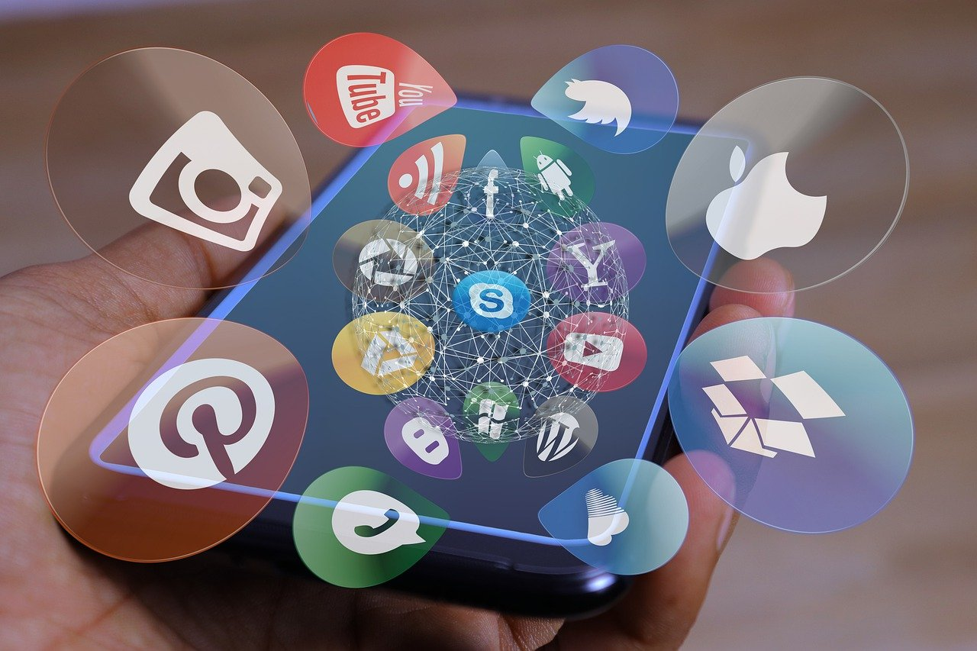
What is Digital Media?
Definition of Digital Media:
Digital media refers to content in electronic format, which can include text, images, audio, and video, that is created, stored, and distributed digitally using technology.
11/24/2023 12:38 PM
5

Slide 6
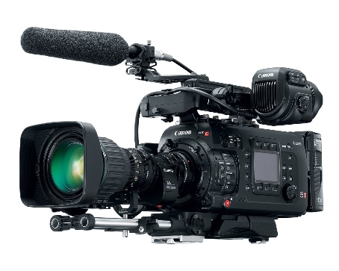
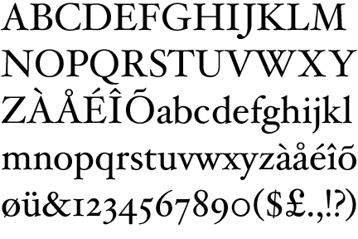
Types of Digital Media
Text: Digital content in the form of written words and documents.
Images: Visual media, including photographs, graphics, and illustrations.
Audio: Sound-based media, like podcasts, music, and voice recordings.
Video: Moving images with or without sound, such as movies, TV shows, and online videos.
11/24/2023 12:38 PM
6

Slide 7
Characteristics of Digital Media
Interactivity: Digital media allows users to actively engage with content, participate in discussions, and provide feedback.
Accessibility: Content can be accessed from anywhere with an internet connection, making it highly convenient and inclusive.
Scalability: Digital media can easily reach a large audience or be personalized for individual users, making it versatile for different purposes.
Multi-modality: It combines various forms of media within a single platform or content, enhancing user engagement and communication.
11/24/2023 12:38 PM
7

Slide 8
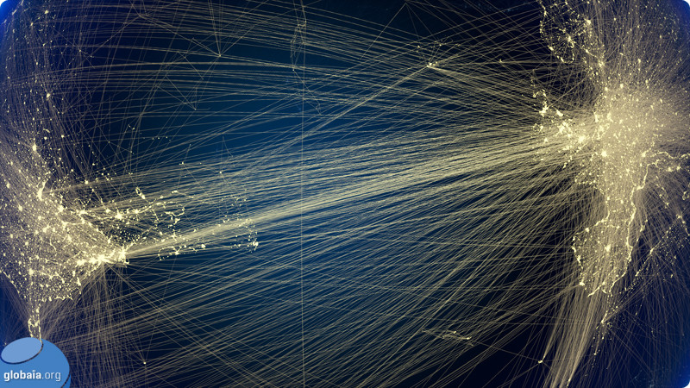
The Impact of Digital Media
Positive Effects of Digital Media:Information Access: Digital media provides instant access to a vast amount of information and knowledge resources.
Connectivity: It connects people globally, fostering communication, collaboration, and community building.
Empowerment: Individuals and communities can use digital media for activism, advocacy, raising awareness, and social change.
11/24/2023 12:38 PM
8

Slide 9
Contd…
Negative Effects of Digital Media:
Misinformation: The spread of false or misleading information online, which can lead to confusion and societal issues.
Privacy Concerns: Concerns related to personal data collection and surveillance by various digital platforms and organizations.
Digital Divide: Unequal access to digital media resources, limiting opportunities for some populations and exacerbating disparities.

Slide 10
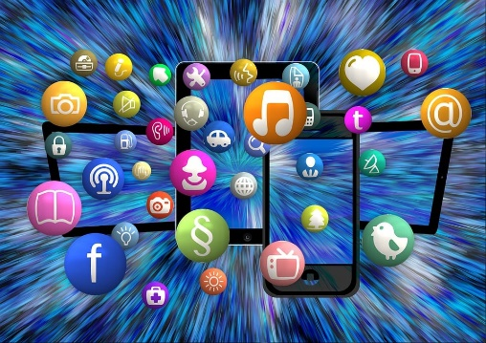
History and Evolution of Digital Media
History and Evolution of Digital Media
Trace the historical development of digital media
Birth of the World Wide Web (1990s):
Tim Berners-Lee's invention of the World Wide Web.
The advent of web browsers and HTML.
Internet and Social Media (2000s-present):Emergence of social media giants like Facebook, Twitter, and Instagram.
Growth of user-generated content, viral marketing, and online communities.
11/24/2023 12:38 PM
10

Slide 11
Digital Entertainment (2000s-present):Streaming platforms such as Netflix, YouTube, and Spotify.
Transition from physical media to digital downloads and streaming.
Digital Journalism (2000s-present):Online news websites and blogs.
The impact of citizen journalism and the 24-hour news cycle.
11/24/2023 12:38 PM
11

Slide 12
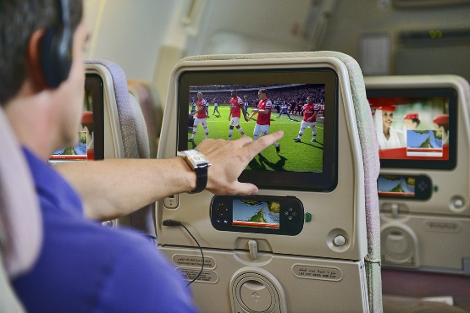
Impact on Media Industries
Publishing and Journalism:
Decline of traditional print media.
Adaptation to digital formats, paywalls, and content distribution challenges.
Entertainment and Broadcasting: Shift from traditional TV and radio to online streaming.
The rise of online influencers and content creators.
11/24/2023 12:38 PM
12

