Slide 1
WOMEN AND MENTAL HEALTH

Slide 2
INTRODUCTION
Women's health refers to the health of women, which differs from that of men in many unique ways. Women's health is an example of population health, where health is defined by the World Health Organization as "a state of complete physical, mental and social well-being and not merely the absence of disease or infirmity". Often treated as simply women's reproductive health, many groups argue for a broader definition pertaining to the overall health of women, better expressed as "The health of women".
Women and men are different not only in their obvious physical attributes, but also in their psychological makeup. Women and men differ in the way they communicate, deal in relationships, express their feelings, and react to stress.

Slide 3
Mental Health And Mental Disorder
Mental health is a term used to describe either a level of cognitive or emotional well-being or an absence of a mental disorder. Mental health may include an individual's ability to enjoy life and procure a balance between life activities and efforts to achieve psychological resilience.
A mental disorder or mental illness is an involuntary psychological or behavioural pattern that occurs in an individual and is thought to cause distress or disability that is not expected as part of normal development or culture.

Slide 4
(Contd..)
Mental disorders can affect women and men differently. Some disorders are more common in women such as depression and anxiety. There are also certain types of depression that are unique to women.
Some women may experience symptoms of mental disorders at times of hormone change, such as perinatal depression, premenstrual dysphoric disorder, and per menopause-related depression. When it comes to other mental disorders such as schizophrenia and bipolar disorder, research has not found differences in rates that men and women experiences these illnesses.

Slide 5
Sex Differences In Prevalence, Onset And Course Of Disorders
Lifetime prevalence rates for any kind of psychiatric disorder -men (48.7%) , women (47.3%)
In childhood: higher prevalence of conduct disorders, for e.g. aggressive and antisocial behaviours- boys> girls.
During adolescence:
• prevalence of depression and eating disorders, and engage more in suicidal ideation and suicide attempts –girls>boys.
• problems with anger, engage in high-risk behaviours and commit suicide –boys>girls.
• adolescent girls are more prone to symptoms that are directed inwardly, while adolescent boys are more prone to act out.

Slide 6
(Contd.)
In adulthood:
• The prevalence of depression and anxiety is much higher in women, while;
• Substance use disorders and antisocial behaviours are higher in men.
• In the case of severe mental disorders such as schizophrenia and bipolar depression, there are no consistent sex differences in prevalence, but men typically have an earlier onset of schizophrenia, while women are more likely to exhibit serious forms of bipolar depression.
In older age groups: Although the incidence rates for Alzheimer’s disease is reported to be the same for women and men, women’s longer life expectancy so, women>men

Slide 7
UNDERLYING FACTORS :

Slide 8
WOMAN ‑ A LIFE CYCLE OF VULNERABILITIES
Wrath of dowry practices, a firm patriarchal family system with the woman having little say, lesser opportunities for education, and employment add to the plight of women. Women’s mental health tends to suffer as they are faced with stressors and are ill‑equipped to cope .
When a woman becomes mentally ill, services are sought infrequently and late. Rather she is blamed for the illness.
The mentally ill woman may be socially abandoned by her husband and her own family. Hence, being a “woman” and being “mentally ill” is a dual curse.
There is distress in married women >married men.
The birth of a child, abortion or miscarriage, economic stresses, and major career changes are some of the stressful events in married life which are mainly gender specific .

Slide 9
MENTAL DISORDERS IN WOMEN
Warning Signs:
Persistent sadness or feelings of hopelessness
Misuse of alcohol and/or drugs
Dramatic changes in eating or sleeping habits
Appetite and/or weight changes
Decreased energy or fatigue
Excessive fear or worry
Hallucinations
Extremely high and low moods
Aches, headaches, or digestive problems without a clear cause
Irritability
Social withdrawal
Suicidal thoughts

Slide 10
(Contd).
Severe Mental Illness In Women:
Although female gender is associated with a favourable outcome, social consequences such as abandonment by marital families, homelessness, vulnerability to sexual abuse, and exposure to HIV; and other infections contribute to the difficulties of rehabilitation of women.
The prevalence rates for sexual and physical abuse of women with severe mental illnesses are twice those observed in the general population of women. In India, the absence of any clear policies for the welfare of severely ill women, and the social stigma further compounds the problem. Stigma has been reported to be more toward ill women than men and also, women caregivers become the target of stigma.

Slide 11
WOMEN’S MENTAL HEALTH: THE FACTS (WHO REPORT,2001)
Depressive disorders account for close to 41.9% of the disability from neuropsychiatric disorders among women compared to 29.3% among men
Leading mental health problems of the elderly are depression, organic brain syndromes, and dementias.
An estimated 80% of 50 million people affected by violent conflicts, civil wars, disasters, and displacement are women and children
Lifetime prevalence rate of violence against women ranges from 16% to 50%
At least one in five women suffers rape or attempted rape in their lifetime.

Slide 12
MENTAL HEALTH INFLUENCES: GENDER DIFFERENCES

Slide 13
COMMON MENTAL DISORDERS (CMD)

Slide 14
(Contd.) DEPRESSION
Depression. Women are twice as likely as men (12 % women compared to 6 % men) to get depression.
Depression in women may be related to changes in hormone levels that occur throughout a woman's life. These changes are evident during puberty, pregnancy, and menopause, as well as after giving birth or experiencing a miscarriage.
In addition, the hormone fluctuations that occur with each month's menstrual cycle probably contribute to premenstrual syndrome, or PMS, and premenstrual dysphoric disorder, or PMDD -a severe syndrome marked especially by depression, anxiety, and mood swings that occurs the week before menstruation and interferes with normal functioning of daily life.

Slide 15
(Contd.) ANXIETY AND PHOBIAS
Anxiety and specific phobias. Although men and women are affected equally by such mental health conditions as obsessive-compulsive disorder and social phobias, women are twice as likely as men to have panic disorder, generalized anxiety, and specific phobias.
Factors affecting:
Hormonal changes during the menstrual cycle
Genetics. Anxiety disorders may run in families.
Traumatic events. Experiencing abuse, an attack, or sexual assault can lead to serious health problems, including anxiety, post-traumatic stress disorder, and depression.
Anxiety disorders are often treated with counselling, medicine, or a combination of both. Some women also find that yoga or meditation helps with anxiety disorders.

Slide 16
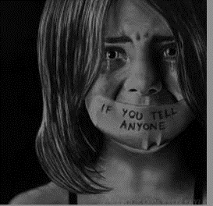
(Contd.) PTSD
Post-traumatic stress syndrome (PTSD). Women are twice as likely to develop PTSD
The primary factor is- experiencing, witnessing, or learning about one traumatic event or a series of traumatic events.
Genetic: specific genotypes may increase or decrease the odds of an individual developing PTSD based on a traumatic experience.
Environmental: Before the traumatic event occurs, environmental influences like low educational progress, poverty, childhood adversity, family history of mental illness, and more can increase an individual’s likelihood of developing PTSD. During and after the traumatic event, elements including the severity of the experience, additional adverse life events, subsequent exposure to reminders of the event, and the lack of strong social support can add to the development of PTSD

Slide 17
(Contd.)
Risk Factors of PTSD:
Being female
Being younger at the time of the traumatic event(s)
Low socioeconomic status
Being a member of a minority racial or ethnic group
Experiencing interpersonal violence
Insufficient social support
Lower intelligence
Lower education level
Prior mental health issues
Poor coping skills

Slide 18
(Contd.) SUICIDE ATTEMPTS
Suicide attempts. Men die from suicide at four times the rate that women do, but women attempt suicide two or three times more often than men. Studies of suicide and deliberate self‑harm have revealed a universally common trend of more female attempters and more male completers of suicide.
Girls from nuclear families and women married at a very young age are at a higher risk for attempted suicide and self‑harm.
Both men and women between the age 18 and 29 while in the age group 10–17, female > male.
As a response to failures in life, difficulties in interpersonal relationships, and dowry‑related harassment.
Causes - disturbed interpersonal relationships followed by psychiatric disorders and physical illnesses. Spousal violence has been found to be specifically associated as an independent risk factor for attempted suicide in women.

Slide 19
(Contd.) Eating Disorders
Eating disorders. Women account for at least 85 percent of all anorexia and bulimia cases and 65 percent of binge-eating disorder cases. Most people who develop eating disorders an estimated 90% are females. Typically associated with adolescents and young women, eating disorders also affect middle-aged or elderly women — although, until fairly recently, not much was known about prevalence in this older age group.
Secrecy and shame are part of the disorder, and women may not seek help. This is particularly true if they fear being forced to gain unwanted weight or stigmatized as an older woman with a "teenager's disease."

Slide 20
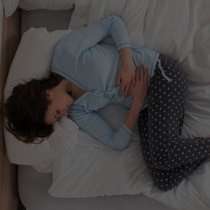
MENTAL HEALTH PROBLEMS RELATED TO REPRODUCTIVE PHASES : MENSTRUATION AND PREGNANCY
Mood and behavioral changes have been observed to be associated with menstrual cycle since ancient times.
The symptoms such as irritability, restlessness, anxiety, tension, migraine, sleep disturbances, sadness, dysphoria, and the lack of concentration occur more frequently during the premenstrual and menstrual phase.
A premenstrual dysphoric disorder consisting of extremely distressing emotional and behavioral symptoms is closely linked to the luteal phase of the menstrual cycle.

Slide 21
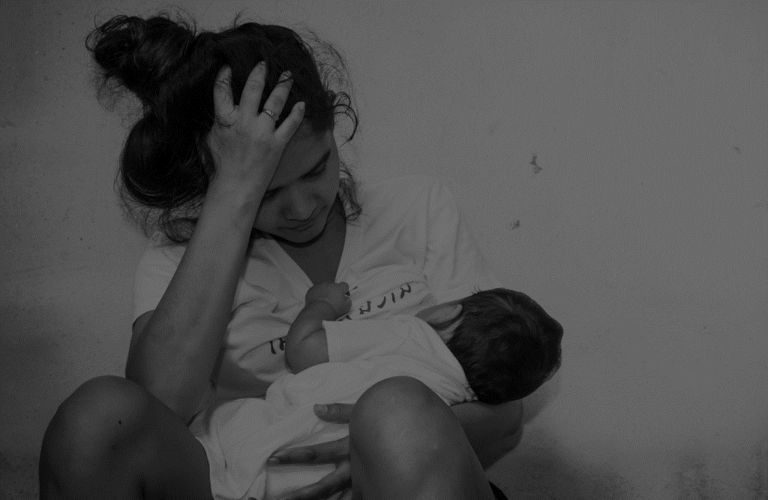
(Contd.)
Mental disturbances frequently occur during late pregnancy and in the postpartum period.
Postpartum blues is the most common and least severe postpartum illness affecting between 50% and 80% of primi mothers, whereas postpartum depression constitutes a major depressive episode with an onset within 6 weeks postpartum in a majority of cases.
In India, depression occurs as frequently during late pregnancy and after delivery as in developed countries, but there are cultural differences in risk factors. The risk is highest among the most socially and economically disadvantaged women.

Slide 22
(Contd.)
The other important risk factors include gender‑based factors such as the bias against female babies; role restrictions regarding housework and infant care; and excessive unpaid workloads; especially in multi‑generational households in which a daughter‑in‑law has little autonomy, and gender‑based violence.
Also, menopause is a time of change for women not only in their endocrine and reproductive systems, but also their social and psychological circumstances. It has long been known that menopause is accompanied by depression and other mental disturbances. Reproductive health factors, particularly gynaecological complaints such as vaginal discharge and dyspareunia are independently associated with the risk for CMD.

Slide 23
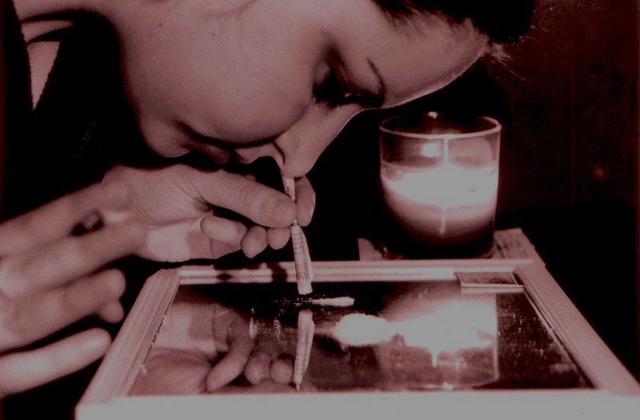
SUBSTANCE USE AMONG WOMEN
Although there are variations between countries, rates of substance abuse – particularly abuse of alcohol, tranquillizers, and analgesics – are increasing around the world.
Women are more likely to attribute their drinking to a traumatic event or a stressor and women who abuse alcohol or drugs are more likely to have been sexually or physically abused than other women.
Significantly more major depression and anxiety disorders are found in females with alcoholism.
Thus, the profile of women with substance use problems differs from that in male abusers. However, despite increasing rates, services to assist women are limited.

Slide 24
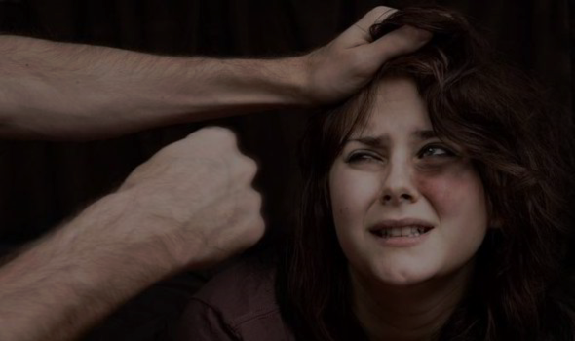
VIOLENCE AND ABUSE AMONG WOMEN
According to an eye‑opening United Nations report, around two‑third of married women in India were victims of domestic violence and one incident of violence translated into women losing 7 working days in the country. Further more,as many as 70% of married women between the ages of 15 and 49 years are victims of beating, rape or coerced sex.
The common forms of violence against Indian women include female feticide (selective abortion based on the fetus gender or sex selection of child), domestic violence, dowry, death or harassment, mental and physical torture, sexual trafficking, and public humiliation.
The reproductive roles of women, such as their expected role of bearing children, the consequences of infertility, and the failure to produce a male child have been linked to wife‑battering and female suicide. The consequences of gender‑based violence are devastating including life‑long emotional distress, mental health issues including posttraumatic stress disorder and poor reproductive health.
Common mental health problems experienced by abused women include depression, anxiety, posttraumatic stress, insomnia, and alcohol use disorders,as well as a range of somatic and psychological complaints. Battered women are much more likely to require psychiatric treatment and are much more likely to attempt suicide than nonbattered women.

Slide 25
HEALTH SEEKING BEHAVIOR
Women reported higher levels of distress than did men, and were more likely to perceive having an emotional problem than men who had a similar level of symptoms. Once men recognised, they had a problem, they were as likely as women to use mental health services.
Men tended to use alcohol as a remedy for relief from temporary strain caused by external pressure, and considered the use of psychotropic drugs as indicating loss of autonomy.
Women, on the other hand, used psychotropics to restore their capacity to carry out emotionally taxing labour related to their caring work in the private sphere.
Women are consistently more likely to use outpatient mental health services than are men. Men may seek care at a later stage after the onset of symptoms, or delay until symptoms become severe.

Slide 26
WOMEN AND MENTAL HEALTH: CARING FOR THEMSELVES

Slide 27
WOMEN’S MENTAL HEALTH SERVICES: IN ABROAD
Women's Mental Health Services at Brigham and Women's Hospital (BWH) and Brigham and Women's Faulkner Hospital (BWFH) are designed to meet the unique needs of women with depression, anxiety and other mental health problems.
The BWH and BWFH mental health team is a group of clinicians with specialized training and expertise in treating women with these and other problems:
Psychiatric symptoms during pregnancy and postpartum
Reactions to infertility or pregnancy loss
Premenstrual mood symptoms
Psychiatric symptoms/emotional changes during the transition to menopause (per menopause)
Non-hormonal treatment of hot flashes associated with mood symptoms.
Reactions to breast cancer, uterine cancer, hysterectomy or other gynaecologic problems.

Slide 28
(Contd.)
During times of reproductive transition (pregnancy, postpartum, and menopause), some women are at heightened risk of developing problems with depression and/or anxiety.
preventive strategies:
Planning for healthy pregnancies for women with pre-existing psychiatric disorders, and/or women who take medications for mood or anxiety problems. This includes consultation about how to minimize risks of psychiatric medications while trying to conceive, during pregnancy, and while breastfeeding, and about alternatives to medication.
Assessing a woman's risk for postpartum depression or anxiety before or during pregnancy, and forming a plan to reduce this risk.
Assessing a woman's risk for developing depression or anxiety during perimenopause, and forming a plan to reduce this risk.

Slide 29
(Contd.)
Service Delivery Issues:
The low detection and referral rates for mental disorders in primary care may affect women disproportionately more than they affect men, because women tend to present to primary rather than referral facilities when they have a mental health problem.
Gender-related experiences and stereotypes on the part of the physician may influence the diagnosis of depression and the higher rates of prescription of psychotropic drugs to women.
Gender stereotyping may also lead to under-diagnosis of mental health problems in men.

Slide 30
SERVICE PROVISION AND UTILIZATION IN INDIA
In India, the absence of any clear policies for the welfare of severely ill women, and the social stigma further compounds the problem.
Psychiatric epidemiological data cite a ratio of one woman for every three men attending public health psychiatric outpatients’ clinics in urban India.
Indian state officials view this as “under‑utilization” by suffering women, attributing it to the greater stigma attached to women’s mental illness that restricts help‑seeking in public health facilities and/or to the lower importance accorded to women’s health generally.
Gender heightens the discrepancy between prevalence and utilization. This low attendance is partly explained by the lack of availability of resources for women in the hospital settings. The mental hospitals appear to cater primarily to men in distress, and there is sex‑based discrimination in the availability of beds

Slide 31
IMPLICATIONS NEEDED FOR MENTAL HEALTH POLICIES AND PROGRAMMES IN INDIA
Mental health policies and programmes should incorporate an understanding of gender issues
Gender-based barriers to accessing mental health care need to be addressed in programme planning.
A public health approach to improve primary prevention, and address risk factors, many of which are gender-specific, is needed
If gender discrimination, gender-based violence and gender-role stereotyping underlies at least some part of the distress, then these need to be addressed through legislation and specific policies, programmes and interventions.
.

Slide 32
(Contd.)
Training for building health providers’ capacity to identify and to treat mental disorders in primary health care services needs to integrate a gender analysis.
Provision of community-based care for chronic mental disorders should be organized to ensure that facilities meet the specific needs of women and men, and that the burden of caring does not fall disproportionately on women.
Making policies will:
reflect and contribute to the government-wide commitment to ensure fairness and equity for all women, of all ages and all backgrounds.
help in laying the foundations
learning and development
help women with leadership

Slide 33
(Contd.)
provide gender-specific provision:
Women-only day services
Crisis houses for women
Single-sex inpatient accommodation
Secure services for women
Education, training, and interventions targeting the social and physical environment.
In primary care: improving access to psychological therapies
Interventions at various levels aiming at both individual women and women as a large section of the society at primary care delivery as well on legal and judicial fronts.
Gender issues in assessment and care planning
Initiatives to tackle violence and abuse
Develop perinatal mental health services to improve recognition of and responses to the needs of women as mothers and care givers.

Slide 36
THANK YOU

